Slide 1

Can same-language subtitles help children become better readers?
Anastasiya Lopukhina
Postdoctoral Researcher, Royal Holloway

Slide 2
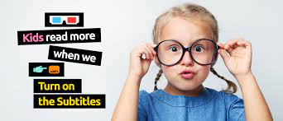
Do same-language subtitles help children learn to read?
The project was inspired by the ‘Turn on the Subtitles’ campaign in the UK.
“Extensive research from top academics in many countries has shown that simply turning on the subtitles for children’s television improves literacy. Dramatically. In fact it may double their chance of becoming a proficient reader …
Promising initiative, but not enough scientific evidence at present.
turnonthesubtitles.org

Slide 3
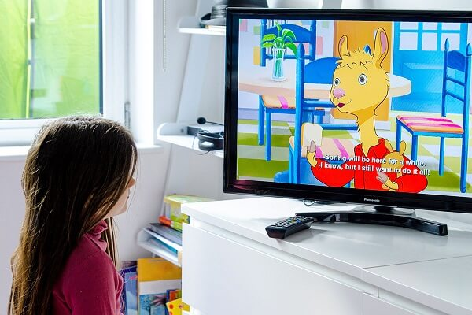
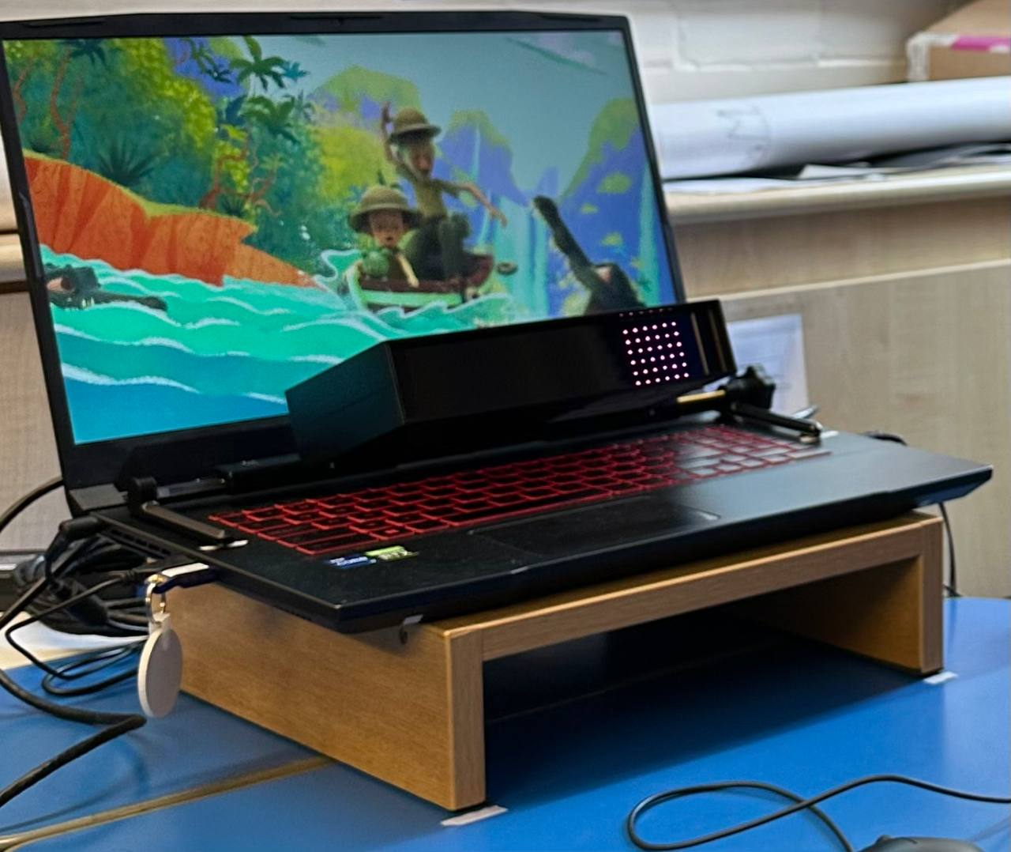
Experiment 1
Do children in primary school look at the subtitles and read them?
Eye tracking during watching videos with subtitles or without subtitles

Slide 4
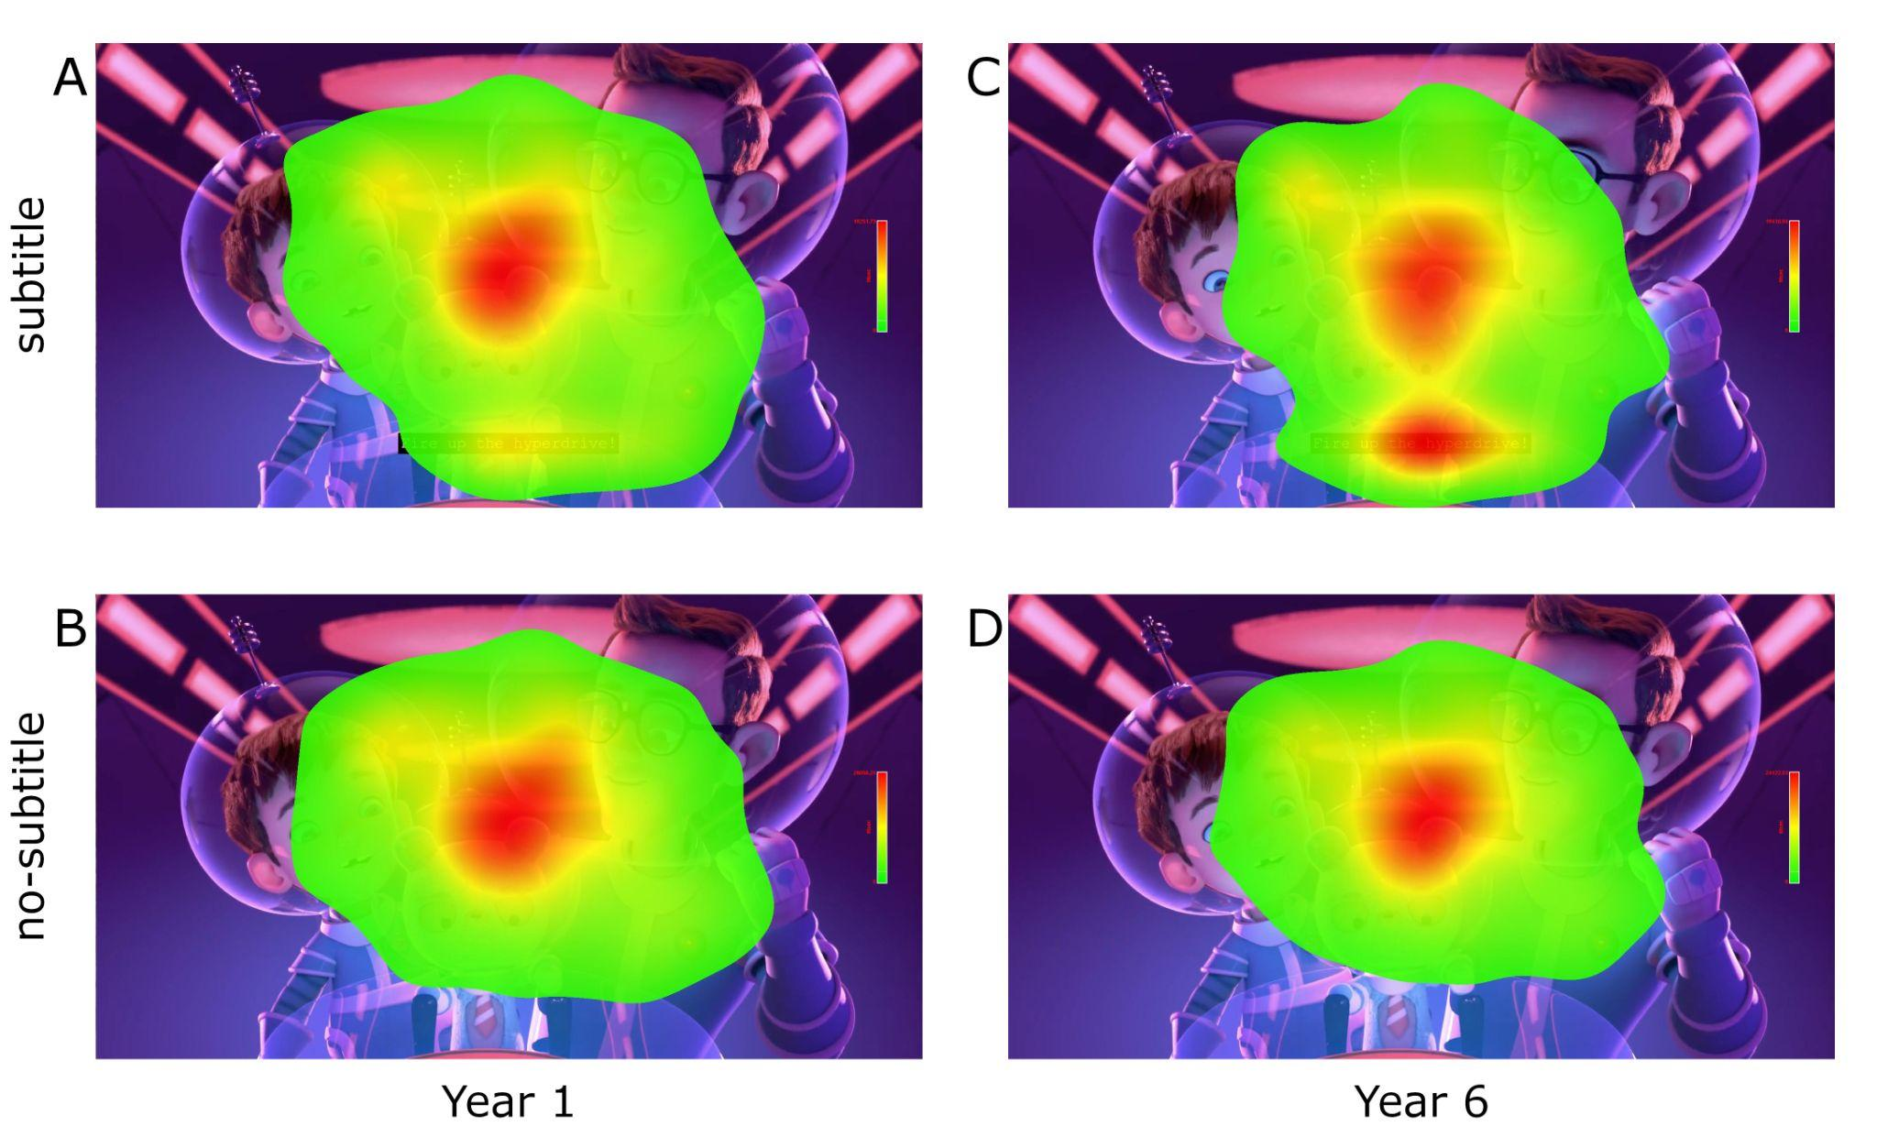
Experiment 1: results
Some degree of reading fluency is necessary before children are able to read the subtitles.
By Years 2-3, they reach this degree of fluency.

Slide 5
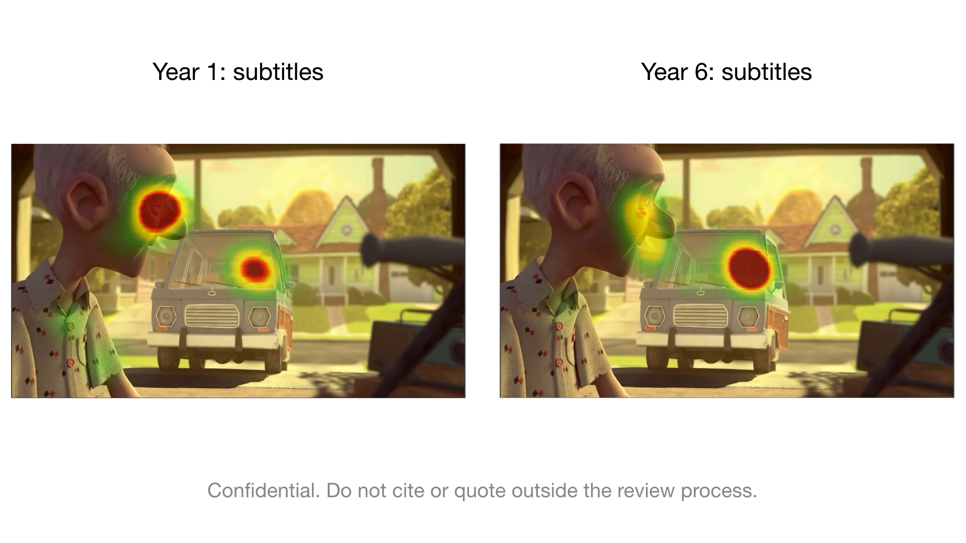
Experiment 1: results

Slide 6
Experiment 2
Does watching television with subtitles improve children's reading?
Notes:
We invite your child to participate in the study if they:
Attend Years 2 or 3
Have English as the main language they speak at home
Have no language or literacy disabilities
Have no (or minimal) experience watching subtitles; and
Watch at least 5 hours of television or streaming services per week.

Slide 7
Experiment 2
Does watching television with subtitles improve children's reading?
We invite schools and children to participate in our study
attend Year 2 or Year 3
have English as the main language they speak at home
have no language or literacy disabilities
have no (or minimal) experience watching subtitles
watch at least 5 hours of television or streaming services per week
Notes:
We invite your child to participate in the study if they:
Attend Years 2 or 3
Have English as the main language they speak at home
Have no language or literacy disabilities
Have no (or minimal) experience watching subtitles; and
Watch at least 5 hours of television or streaming services per week.

Slide 8
Three phases of the study
Pre-test
(at school / in RHUL
psychology labs)
Intervention
(in home)
Post-test
(at school / in RHUL psychology labs)
reading skills
attention to subtitles
reading attitudes
vocabulary
reading skills
attention to subtitles
Notes:
The study will have three phases.
In the first phase, we’ll test children individually at school on their reading skills, their reading attitudes , their vocabulary, and how much they look at subtitles while watching television using our eye-tracker. This will take around one hour.
In the second phase, we’ll ask you to do an intervention at home over a six week period, which I’ll tell you about in just a minute.
In the third phase, we’ll repeat some of the same tests used in the first phase, and this will again take around an hour.

Slide 9
Three phases of the study
Pre-test
(at school / in RHUL
psychology labs)
Intervention
(in home)
Post-test
(at school / in RHUL psychology labs)
Watching TV and streaming services with subtitles for six weeks
Watching TV and streaming services without subtitles for six weeks
For at least 5 hours a week (≈ 315 pages read on captionsON calculator), including g some episodes from a list of recommended videos on CBBC that we will provide. In total, min 30 hours of subtitles viewing.
Notes:
During the six week period at home, we’ll put the children into two groups.
One group will be asked to watch TV and streaming services WITH subtitles for six weeks.
The other group will be asked to watch TV and streaming services WITHOUT subtitles for six weeks.
You’ll need to watch TV or streaming services for at least 5 hours per week. You can watch whatever you want but we’ll ask you to watch a few episodes of shows that we select from CBBC each week.

Slide 10
We need parents’ assistance during the intervention
Make sure that the subtitles are turned on or turned off for six weeks.
On Monday-Friday, we will send the parents a text message asking 3 short questions about watching television that day. They will take 30 seconds of their time.
On Sunday, we will send the parents a short survey asking about television viewing time and the content of the recommended videos that your child watched. It will take 10 minutes of their time.
Six weeks after the post-test, we will contact the parents to discuss your child’s reading and television viewing habits.
Parents are paid £50. If tested in schools, then we pay the school £10. If parents need to travel to the lab, then we give a travel payment of £25 for the two visits. The child will get a gift.
Notes:
We’ll need some assistance from parents during the 6-week period but we’ve tried to keep this to a minimum because we know that everyone has very busy schedules.
First, we’ll ask you to make sure that subtitles are turned on or off for the full six weeks.
Second, on each weekday, we’ll send you a text message asking 3 short questions about television that day. These text messages are designed to take no more than 30 seconds of your time.
Third, on Sundays, we will send you a short survey asking about television viewing time, and which shows your child watched. These surveys will take 10 minutes of your time.
Finally, six weeks after the final test, we’ll contact you to discuss your child’s reading and television viewing habits.
We know that this is a lot to ask, so our funder will allow us to pay parents £50 for completing the study. We’ll also be able to pay you £25 for your travel to Royal Holloway, or if your child is tested in school, then we can pay your child’s school £10 for their help in organising the testing. Your child will also get a small gift.

Slide 11

What do we expect
We are testing a hypothesis that six weeks
of subtitles exposure will
improve reading fluency, as measured
by standard tests and eye-tracking.
‘Subtitles’ group
Control group
Pre-test
Post-test
Notes:
We are testing a hypothesis that six weeks of subtitles exposure will improve reading fluency, as measured by standard tests and eye-tracking.

Slide 12
First feedback from the children and parents
It’s easier to hear what’s being said with the help of subtitles. My son says that if he doesn’t catch what was said through speaking, he can pick it up through the words on the screen.
My daughter thinks they are good because when you watch the TV you can read them and concentrate more.
He doesn't like subtitles very much and didn’t try to read them.

Slide 13
First feedback from the children and parents
It’s easier to hear what’s being said with the help of subtitles. My son says that if he doesn’t catch what was said through speaking, he can pick it up through the words on the screen.
My daughter thinks they are good because when you watch the TV you can read them and concentrate more.
He doesn't like subtitles very much and didn’t try to read them.
My daughter has been wanting to read more on her own, particularly before bedtime.
I believe the subtitles have helped my child with her reading.
On occasion she came to me asking the meaning of words which she had seen on the subtitles. I felt would not be asked if the subtitles were not on.
7/10 families would like to turn on the subtitles after the end of the project.

Slide 14
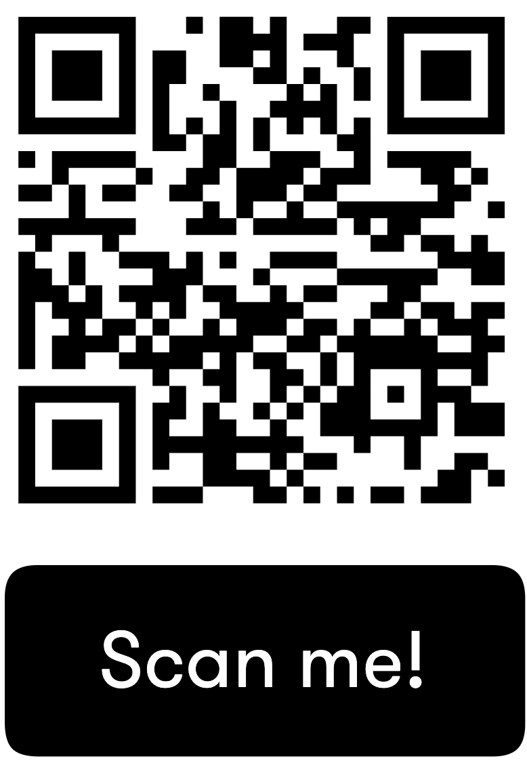
Join us for this study
We need local schools to support us to conduct this study.
Can you host us or advertise the study to families next term?
Contact us: subtitles.rhul@gmail.com
Visit our webpage to learn more about the study: www.rastlelab.com/intervention
Or watch our short video by scanning the QR code:
Notes:
You could also mention that Ellie is here and has been supporting both of these studies in her schools, and that we're sure she would be willing to speak with any teachers about their experience.

