Slide 1
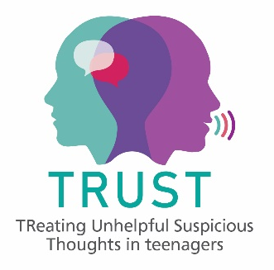




Paranoid beliefs in adolescents
Dr Jess Kingston
Co-Research Director, DClinPsy
Senior Lecturer in Clinical Psychology
Jessica.Kingston@rhul.ac.uk

Slide 2
What is paranoia?
“[paranoia] is quite common, more common than people think... people feel shame about it because there is a lot of stigma ..... and there isn’t enough support in school” ...
“feeling someone might harm you or someone is out to get you ...for me it was like very paralysing ... like ... I would be quite frozen.... makes me not able to do anything or concentrate on anything”.
17 and 18 year olds with lived experience of paranoia

Slide 3


Paranoia...
exaggerated fears that others intend to cause you harm
Common in the general population
Experiences range on a continuum from mild mistrust and suspicion to clinically-significant persecutory delusions (Freeman et al. 2018).

Slide 4
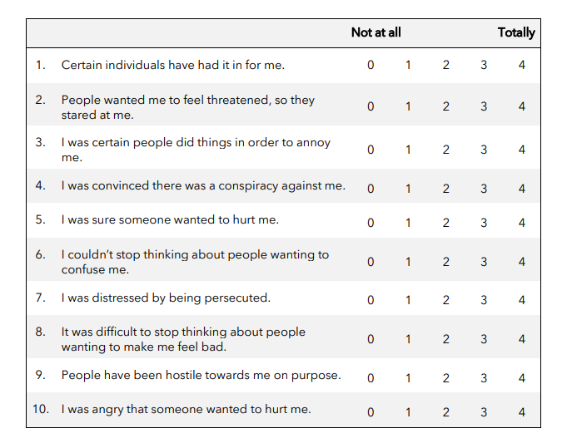

Slide 5
How common are paranoid beliefs in adolescents?
 | Adolescents | Adults (Freeman et al., 2019)
General population | N=859, M=7.39 (SD=10.22) | N=7279, M=4.52 (SD=6.74)
MH diagnosis | N=214, M=13.18 (SD=12.72) | N=982, M=8.12 (SD=9.35)
In a UK school-attending adolescent sample (n=1073)
16.9% YP scored >=18 on RGPTS indicating “likely persecutory delusions”.
27.6% scored >= 11, indicating “persecutory ideation”.
33% of “persecutory ideation” sample reported MH diagnosis
34% of “persecutory delusions” sample reported MH diagnosis

Slide 6
Moving to secondary school – school perspective
Felling unsafe in corridors and toilets
Worried older kids might talk to them, call them names, roll their eyes
Scared of walking home and people harming them

Slide 7
Being an Adolescent
Bullying
Belongingness
Mood fluctuations
Puberty
Identity
Paranoid beliefs
Changes to sleep
World as more dangerous
Unique phase of development, characterised by a number of significant social, cognitive, behavioural and neurodevelopmental changes
Notes:
Why cant we just extrapolate from adults?
YP are developing a sense of self based on how they perceive that others perceive them – and during this stage of dev this will be overly negative

Slide 8
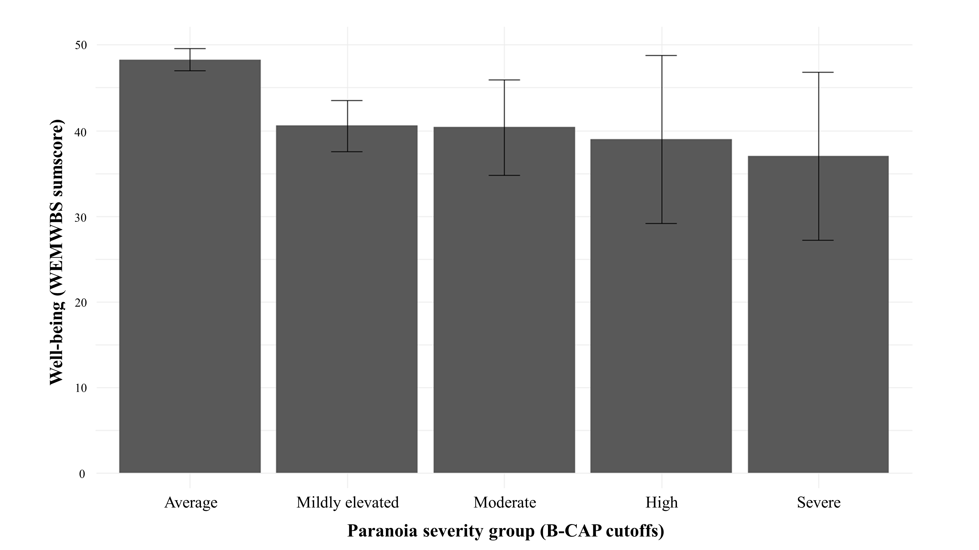
Paranoia and well-being
Schools project measuring paranoia (IV), well-being (DV), self-esteem, worry and judging oneself (mediators) at BL, 2 and 6-weeks later (14-16 years olds, n=133)
“average”- WB scores comparable to other adolescent and adult groups (M=48.29, SD=9.86, Med=49).
“mildly elevated” to “severe”, WB significantly lower (M= 40.06, SD=9.04, Med=41; t = 5.45, p < 0.001
Paranoia predicted reductions in WB overtime
paranoia reduced WB via its impact on the young people’s self-esteem
Kingston, J., Parker, A., Schlier, B. (2022). Effects of paranoia on well-being in adolescents: A longitudinal mediational analysis. Schizophrenia Research. https://doi.org/10.1016/j.schres.2022.03.009

Slide 9
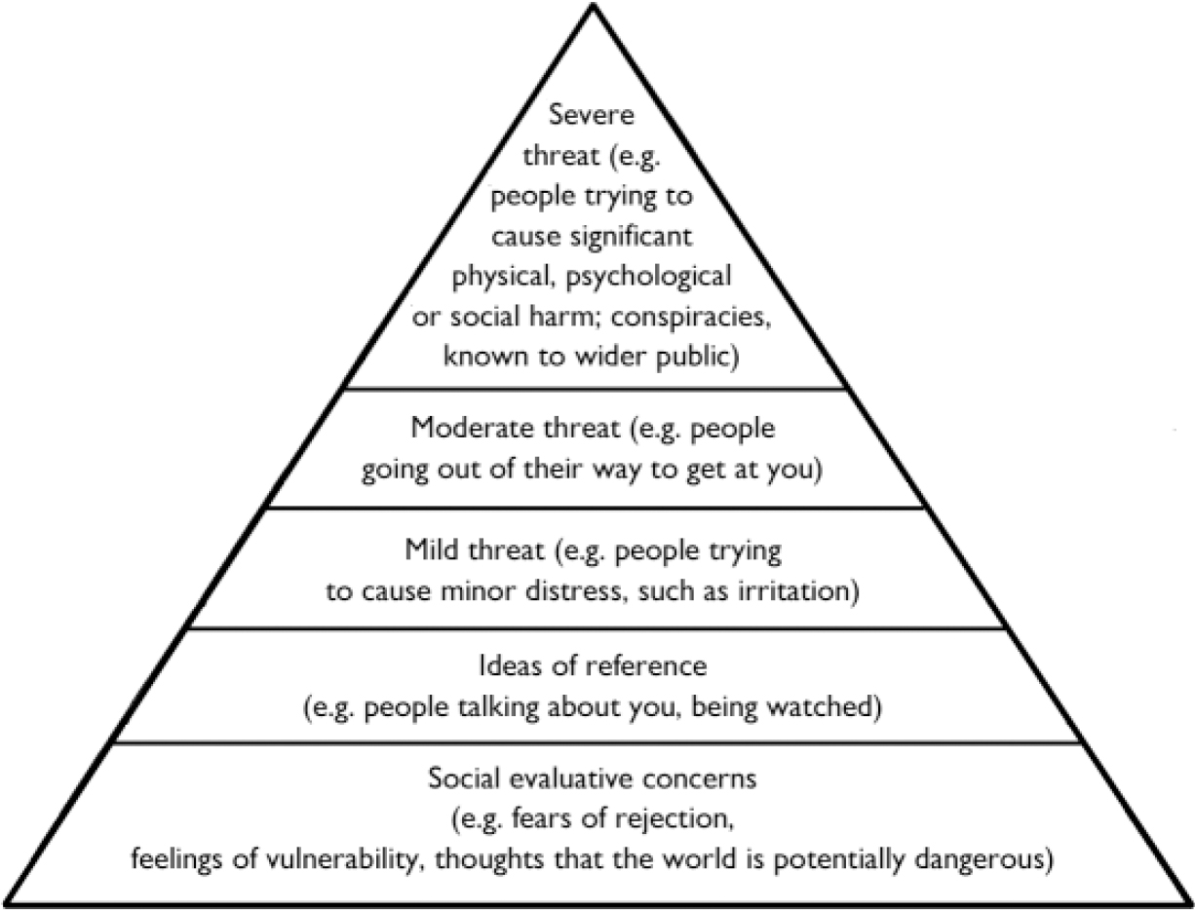
Freeman et al., 2005

Slide 10
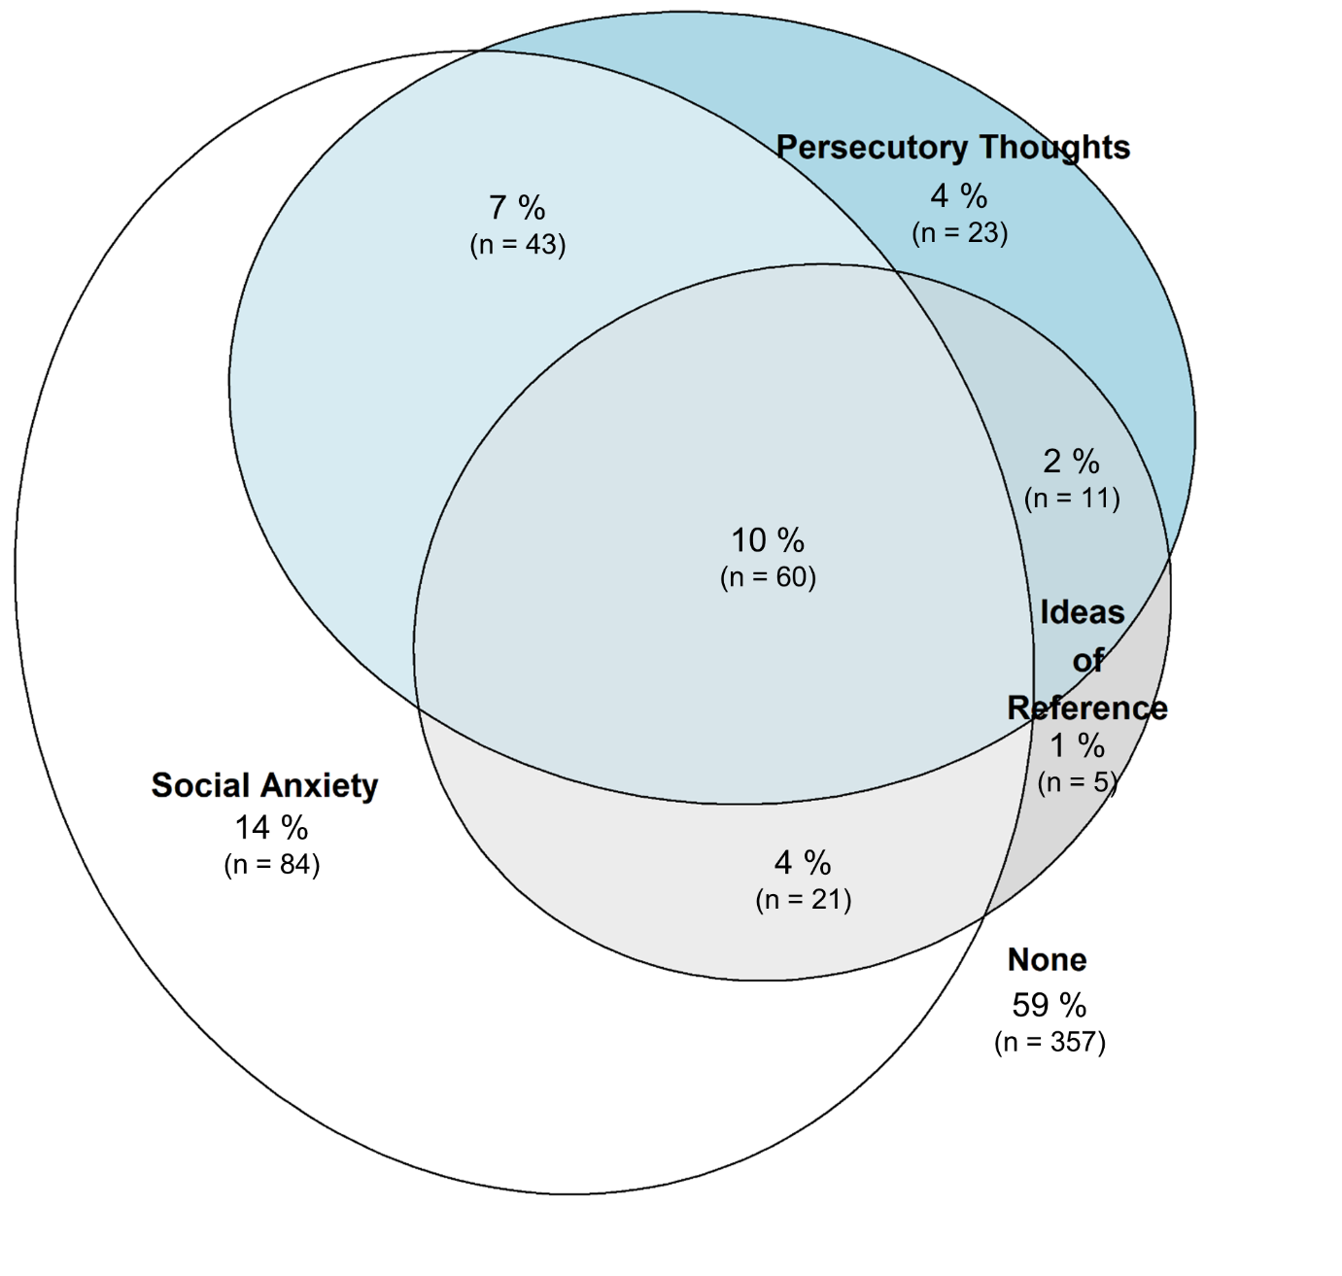
Social anxiety and paranoia in adolescents
N=604 GP adolescents
Largest subgroup - elevated social anxiety and paranoia (21%, n=124)
Next, high social anxiety only (14%, n=84)
Participants with only high Ideas of reference and/or ideas of persecution were considerably less prevalent (6%, n=39)

Slide 11
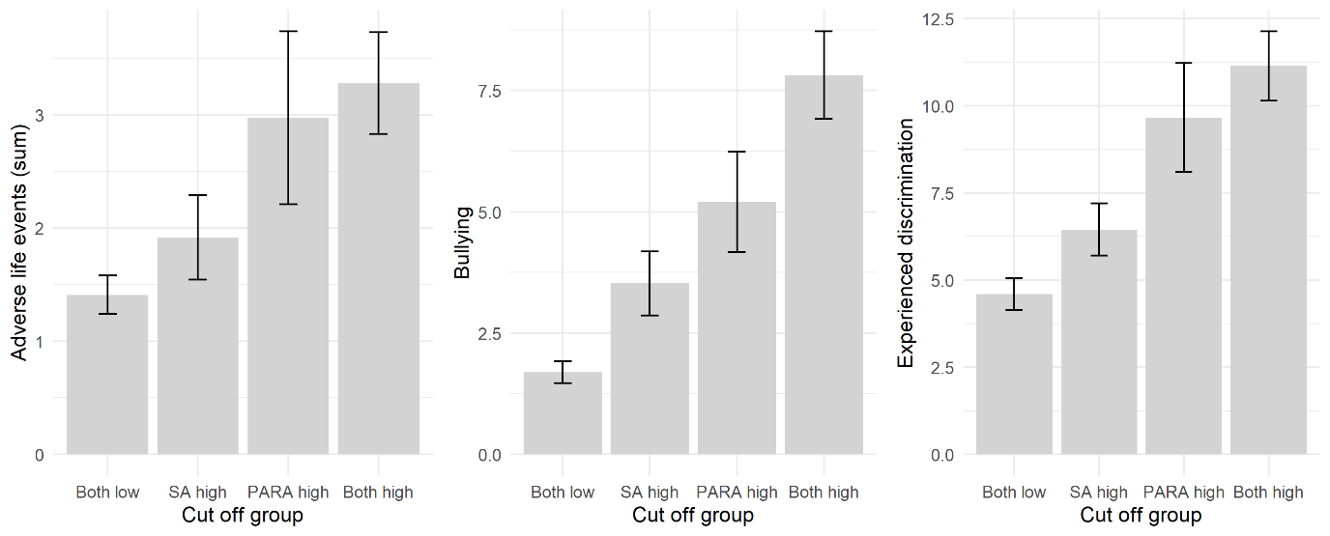
Psychosocial risk: ALE, Bullying, discrimination
*
*
*
*
*
For this cluster, those with paranoia with or with SA had significantly higher scores

Slide 12
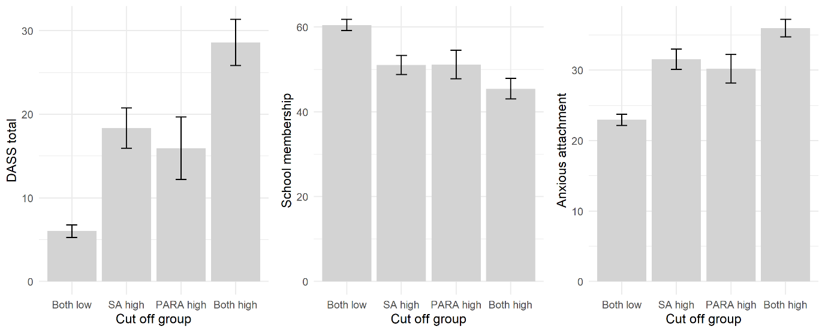
Distress, school membership, anxious attachment
Both-low group showed most favourable mean scores, both-high group showing the least favourable mean scores

Slide 13
Family context
N=142 adolescent and parent dyads
ALE and bullying were significantly associated with paranoia (r=.21 & r=.61)
Adolescent paranoid beliefs were significantly associated with parental stress (r=.32)
Parental stress sig. modified the ALEs-> paranoia pathway
R = .395, R² =.156, F = 4.97, p = .003
Interaction effect B= .095, SE .046, t = 2.07, p = .04
Kingston et al., (2023). A child-parent dyad study on adolescent paranoia and the influence of adverse life events, bullying, parenting stress and family support. Schizophrenia Bulletin, 29;49(6):1486-1493. doi: 10.1093/schbul/sbad119.

Slide 14

When parents reported low and moderate levels of parenting stress (i.e., high and moderate levels of parental warmth), exposure to ALEs was not related to paranoid beliefs in the adolescent.
However, when parents reported high levels of parenting stress and low levels of warmth, exposure to ALEs was strongly associated with paranoid beliefs in the adolescent.

Slide 15

Summary
Feeling suspicious, mistrusting and paranoid in adolescents is common
Teenagers do not tend to talk to adults about it
Talking to teenagers with paranoia suggests it can feel stigmatised and shameful
For a minority of teenagers, it can escalate into serious and persisting beliefs that have lifelong implications

Slide 16

School projects
Tracking paranoid beliefs in young people to better understand why it gets worse for some young people and, in particular, the factors that trigger escalation into psychosis
Treatment of paranoia beliefs via schools-based intervention

Slide 17

Thanks for listening
Questions?!

