Slide 1
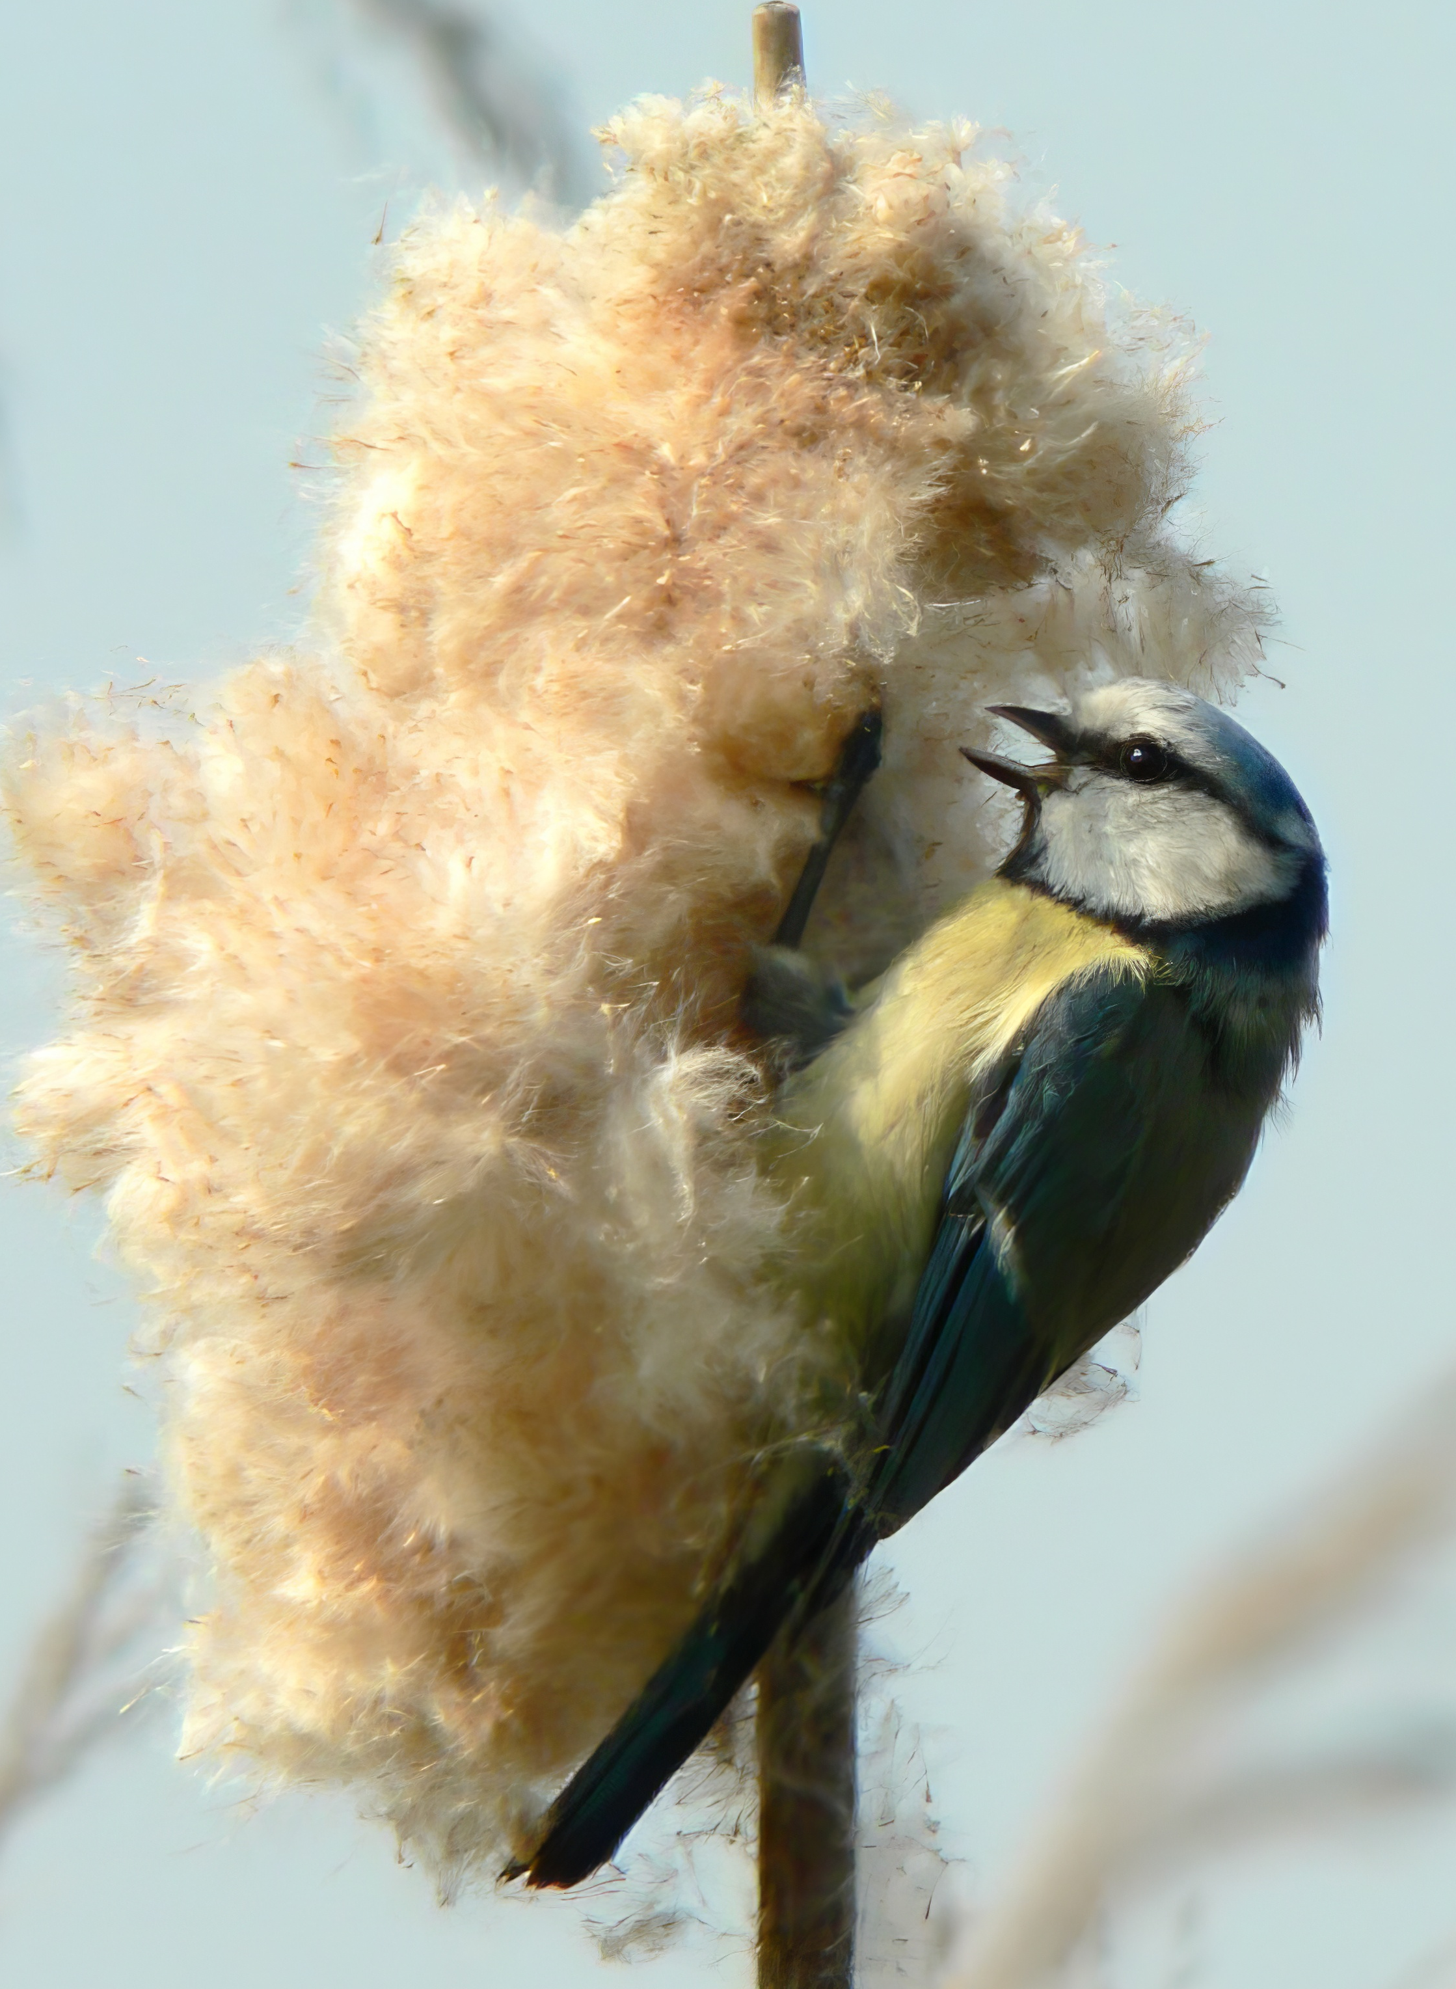
Teaching evolution without a time machine
Warren Horrod-Wilson and Rob Lachlan
Warren.Horrod-Wilson.2022@live.rhul.ac.uk

Slide 2
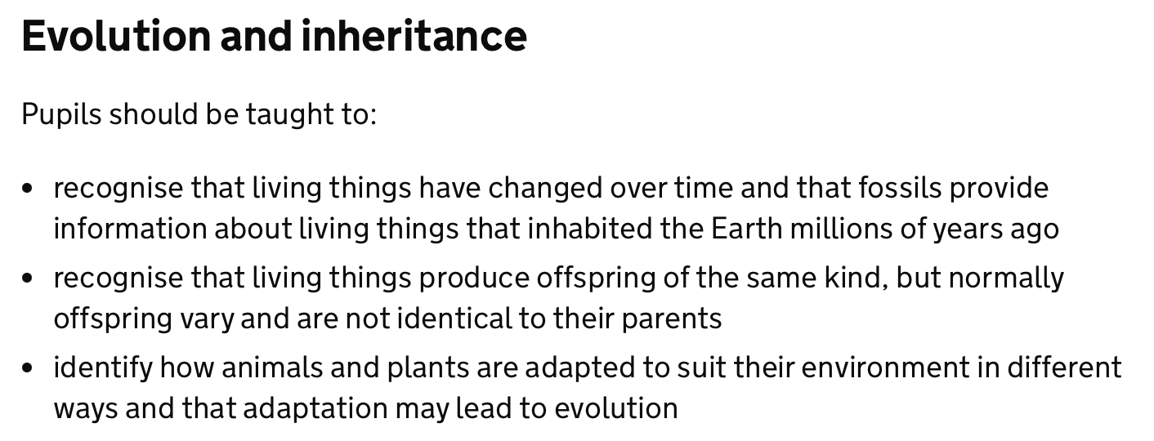
Context – National Curriculum Y6
Source: https://www.gov.uk/government/publications/national-curriculum-in-england-science-programmes-of-study/national-curriculum-in-england-science-programmes-of-study

Slide 3
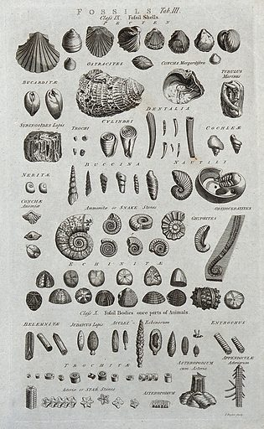
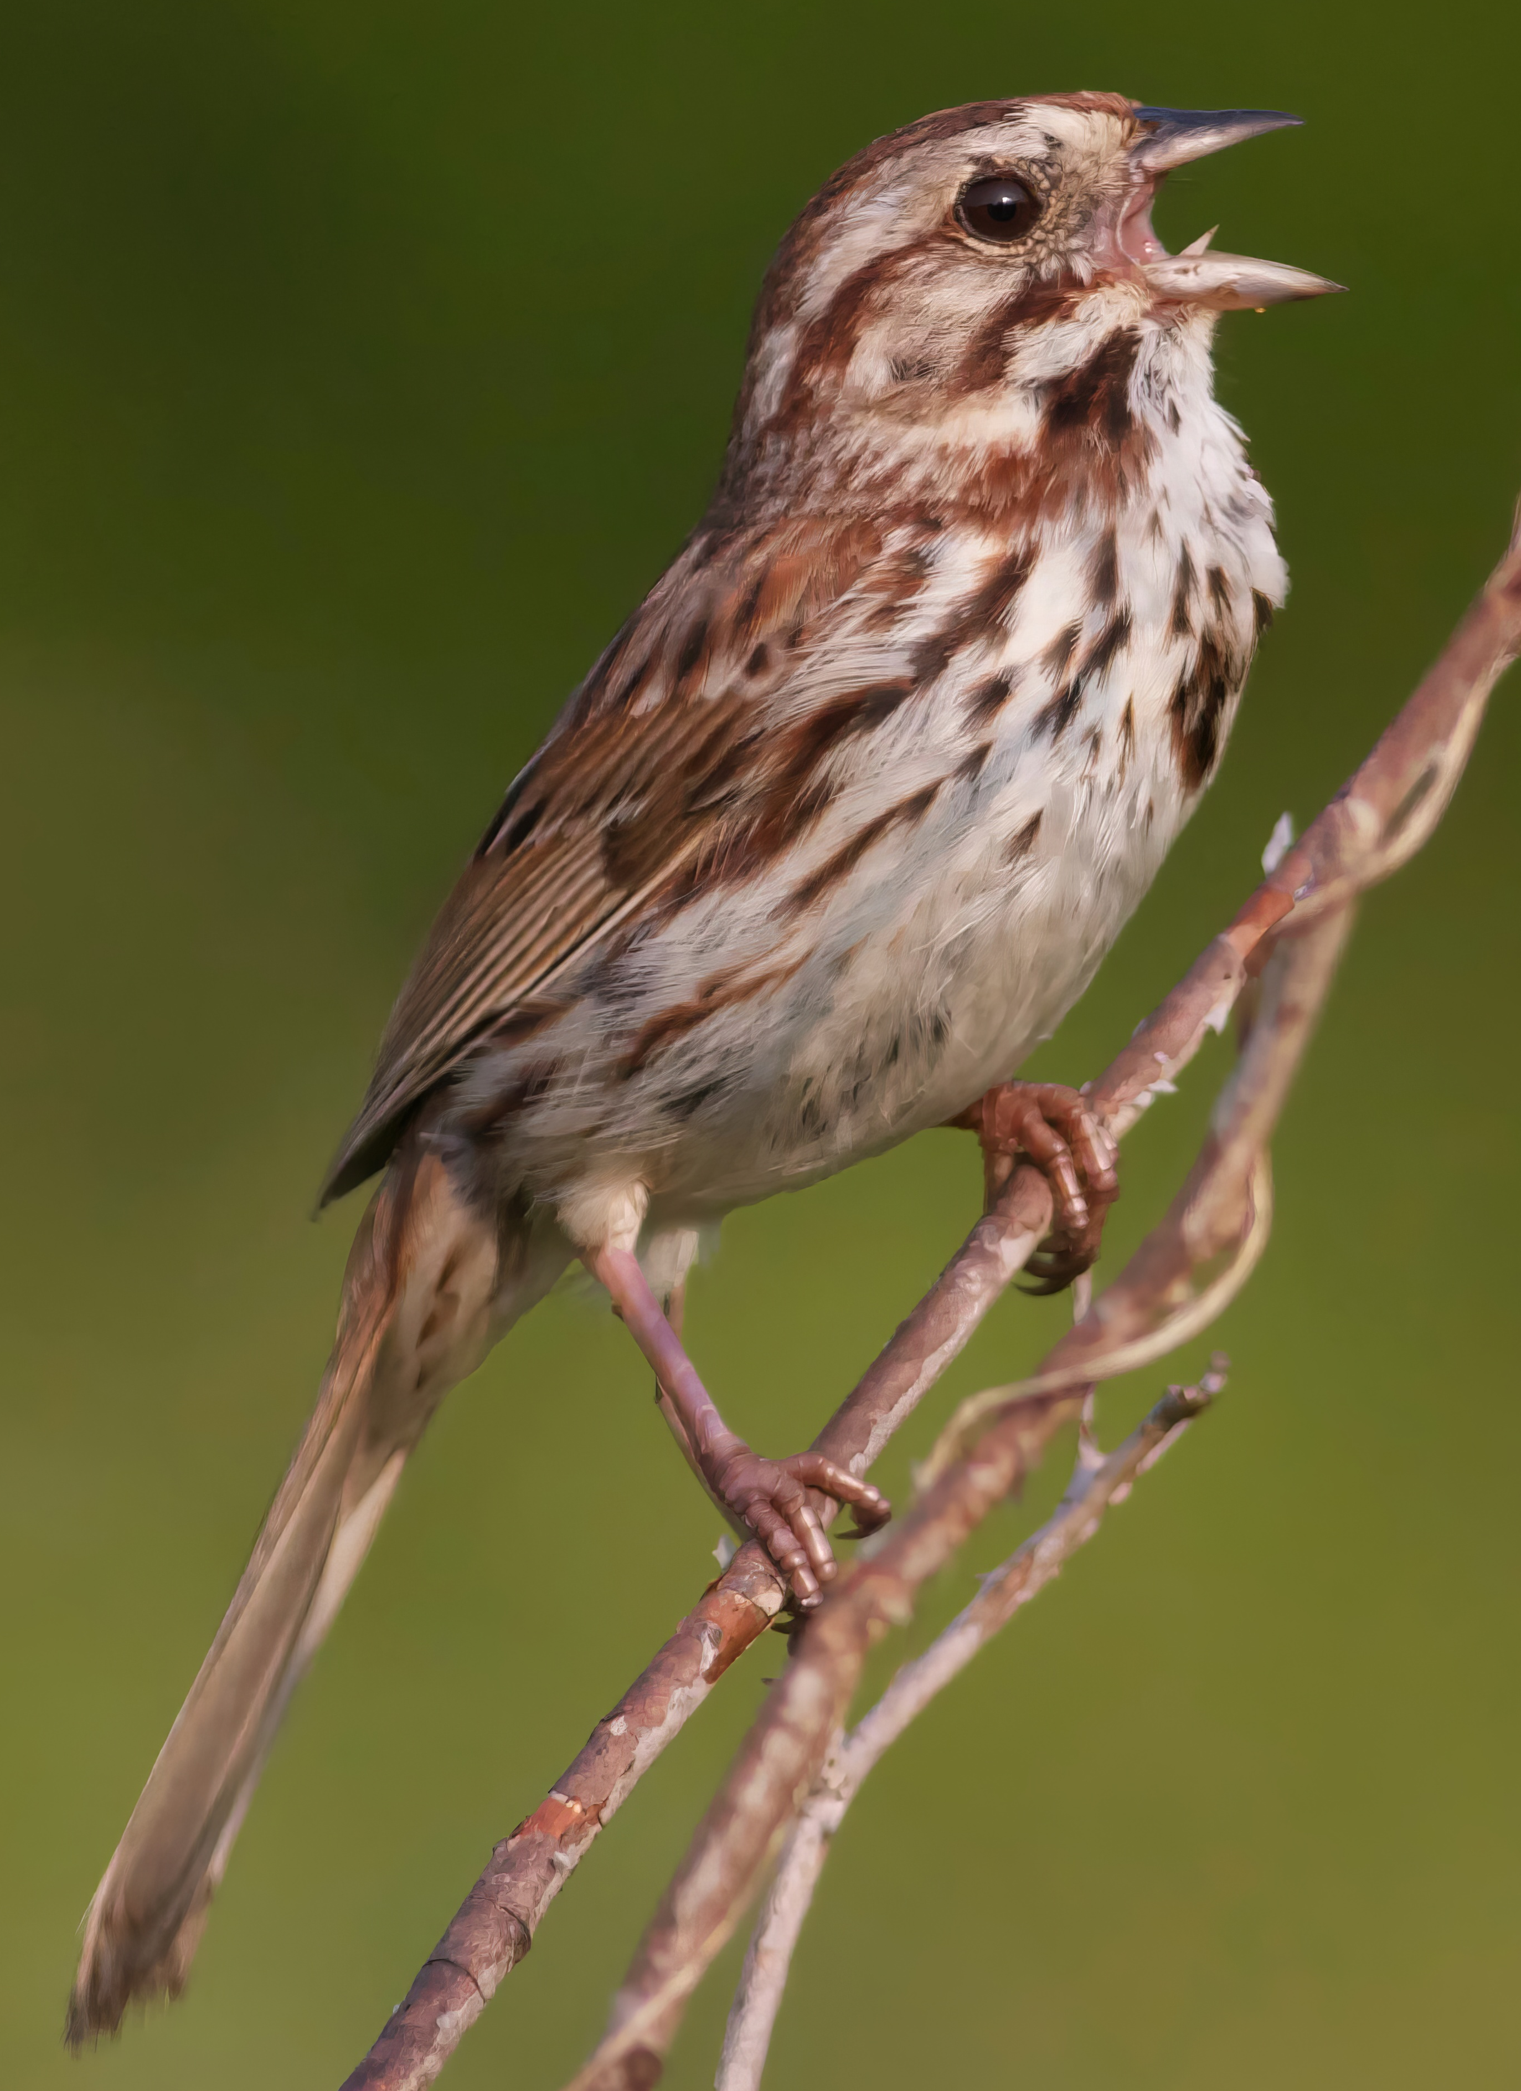
The Challenge: Evolution (as commonly understood) takes millions of years
  How can we bring this topic to life?
  How can we provide students with an intuitive “feel” for the evolutionary process?
  How can we make this a topic that contributes to building a “science identity”

Slide 4
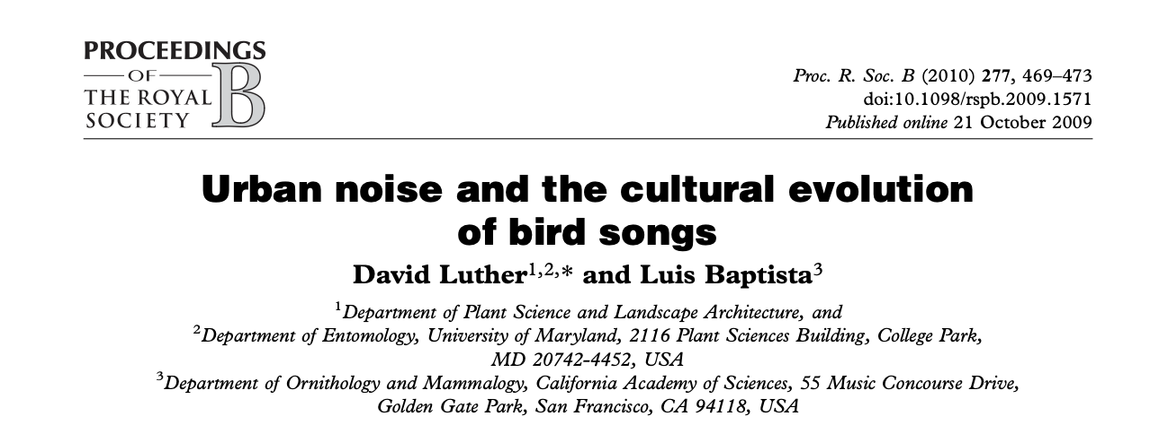

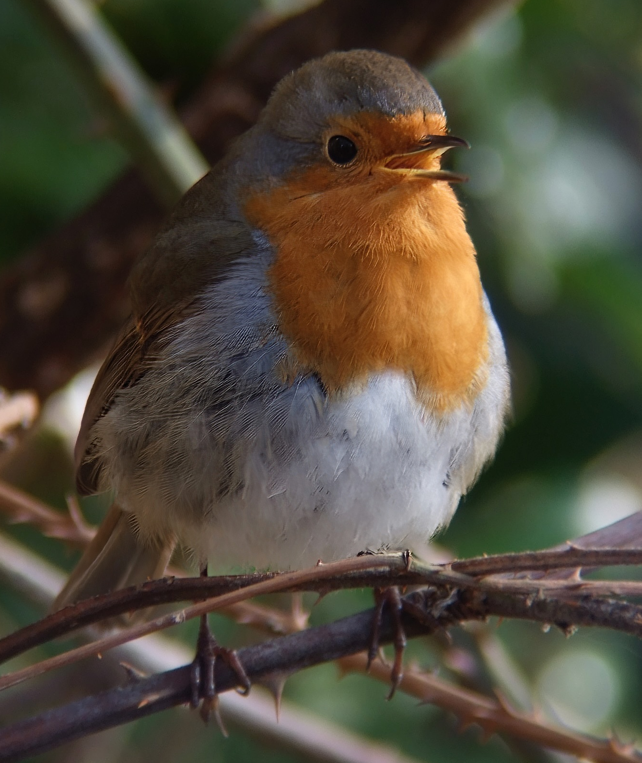
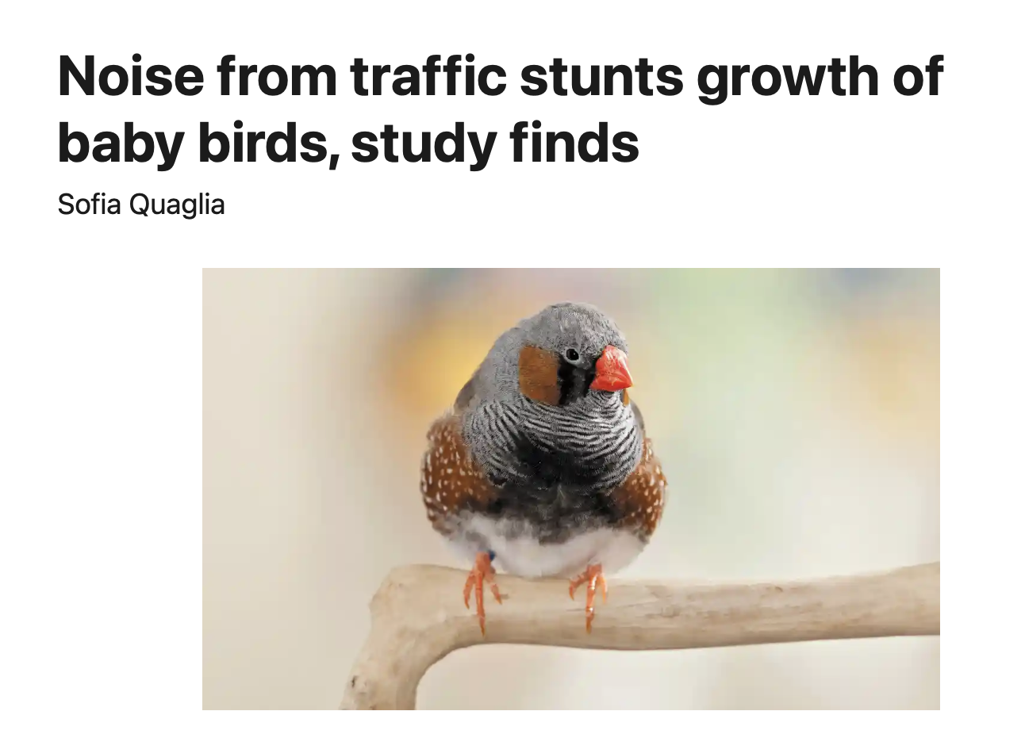
Our Project: Bird Song Science
How are bird songs evolving across the UK in response to traffic noise / pollution?
  Builds on current scientific question (i.e. it’s real science)
  Relates to issues that are of immediate importance: how are we changing the environment? (i.e. extrinsic as well as intrinsic value)
  Bird song part of our day-to-day life (sustained effect of intervention)

Slide 5
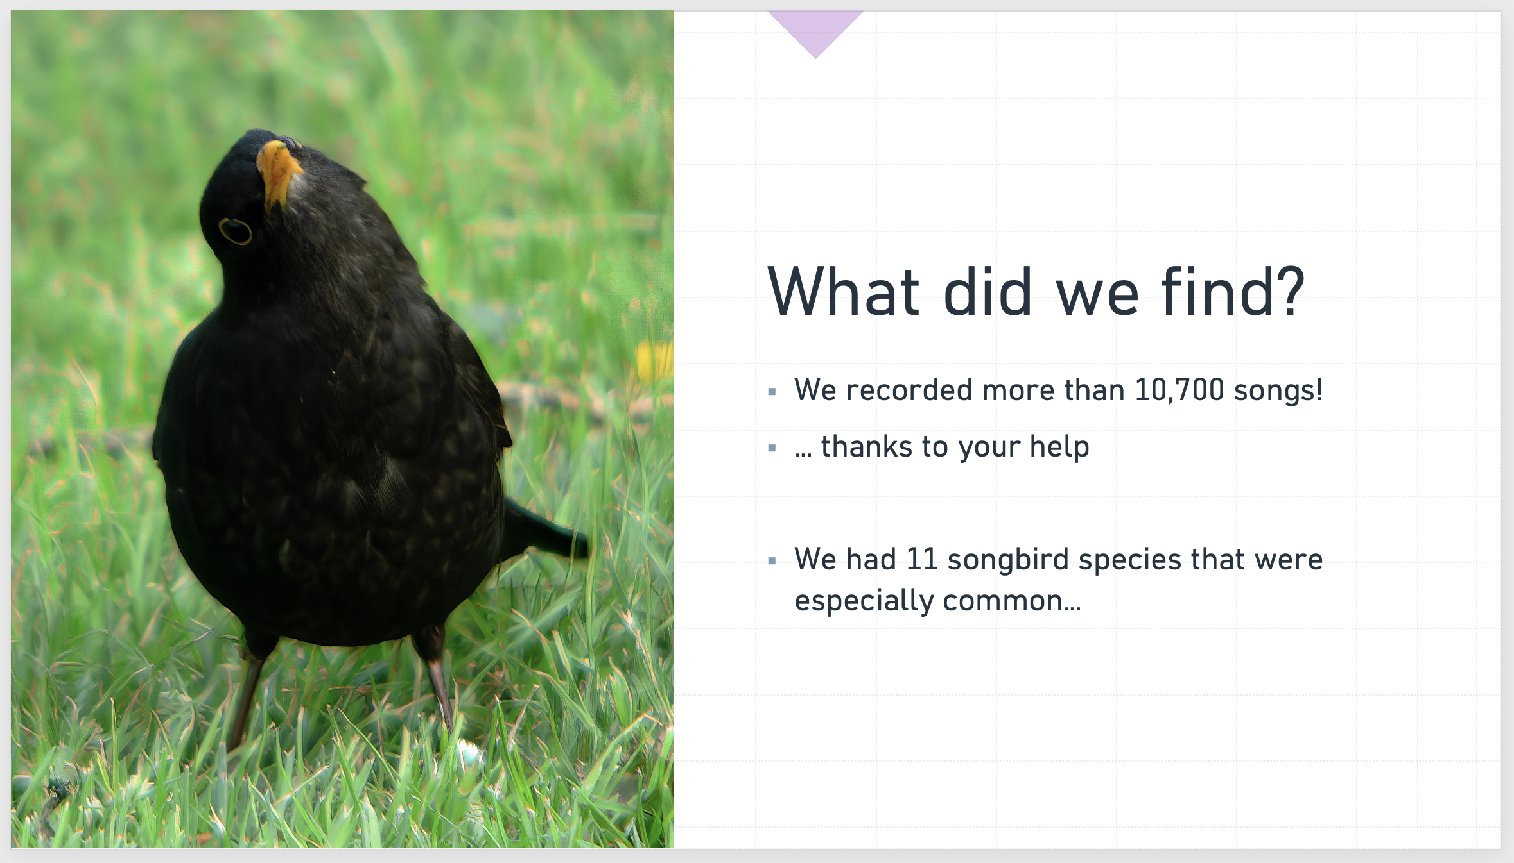
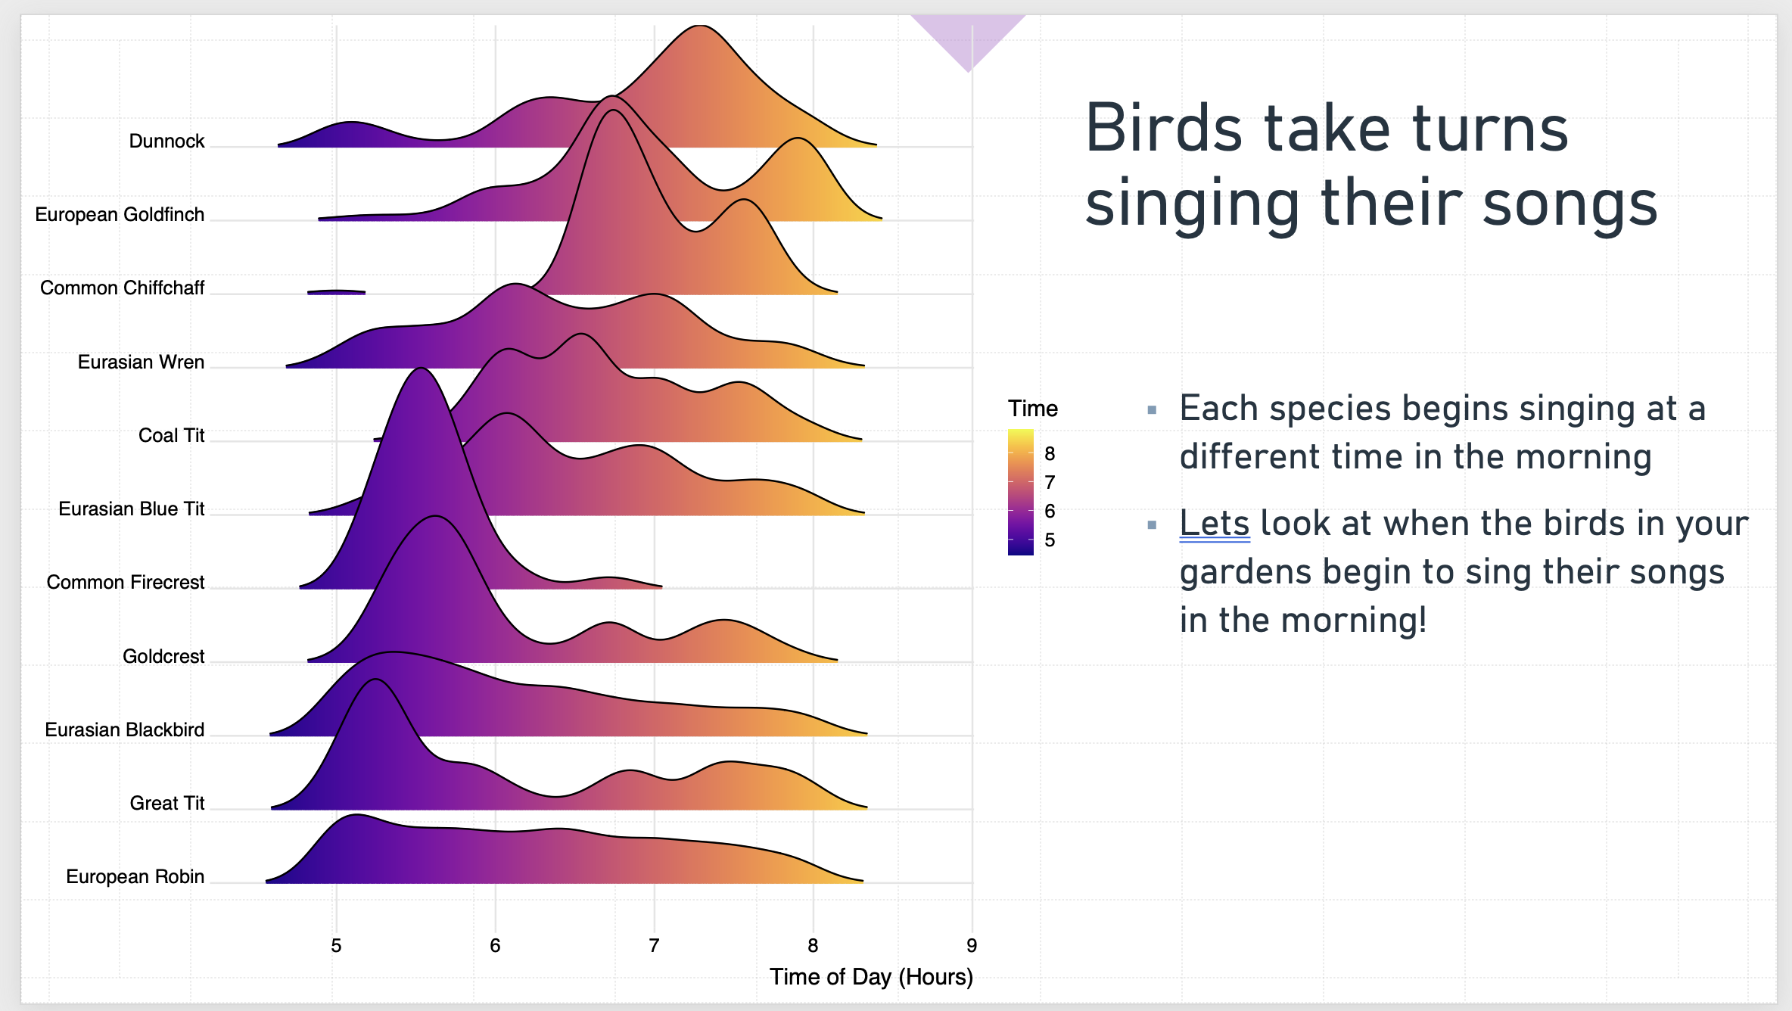
Our Project: Bird Song Science
Components
  Initial lesson with hands on activities with spectrograms and game
  Children take our recorder home and leave it in their garden overnight
  We analyse data and present results in follow-up visit

Slide 6
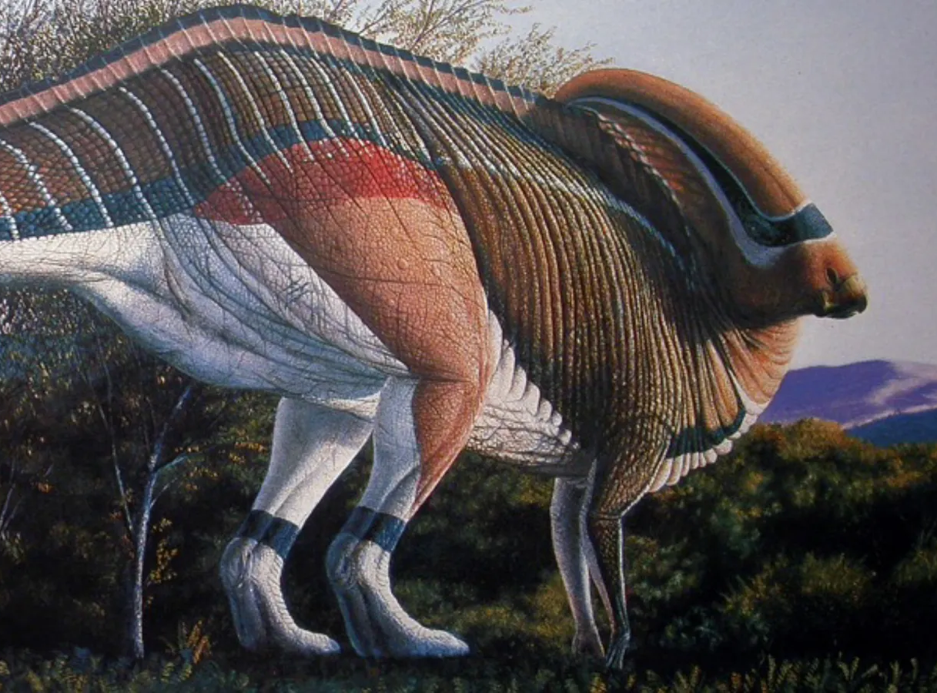
Here’s how we think dinosaurs may have actually sounded
https://www.bbc.com/future/article/20221212-the-mysterious-song-of-the-dinosaurs

Slide 7
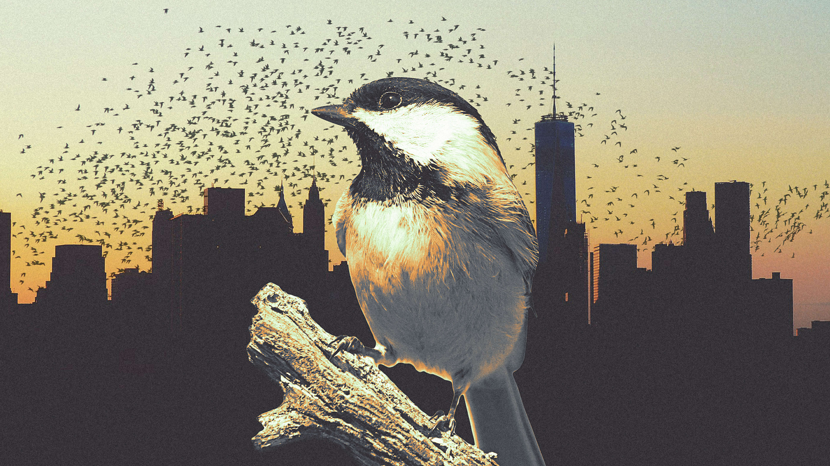
Songbirds in the City
How does noise and human activity affect the evolution of communication?
Noise from human activity may influence sound transmission
Do birds in quieter areas sound more similar than birds in noisier areas?
We need you to help us find out!

Slide 8
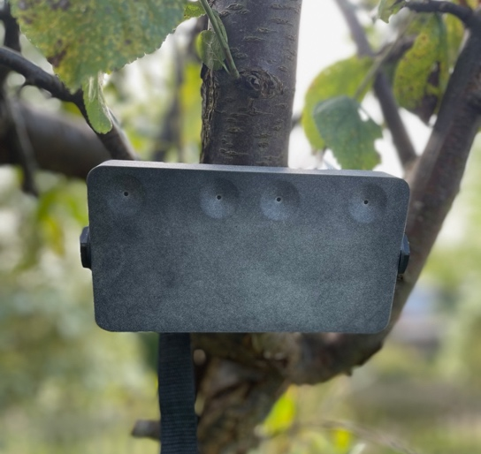
Recording Boxes
Your scientific equipment
Make sure to set it up in a clear space, pointing in the direction of a bush or tree

Slide 9
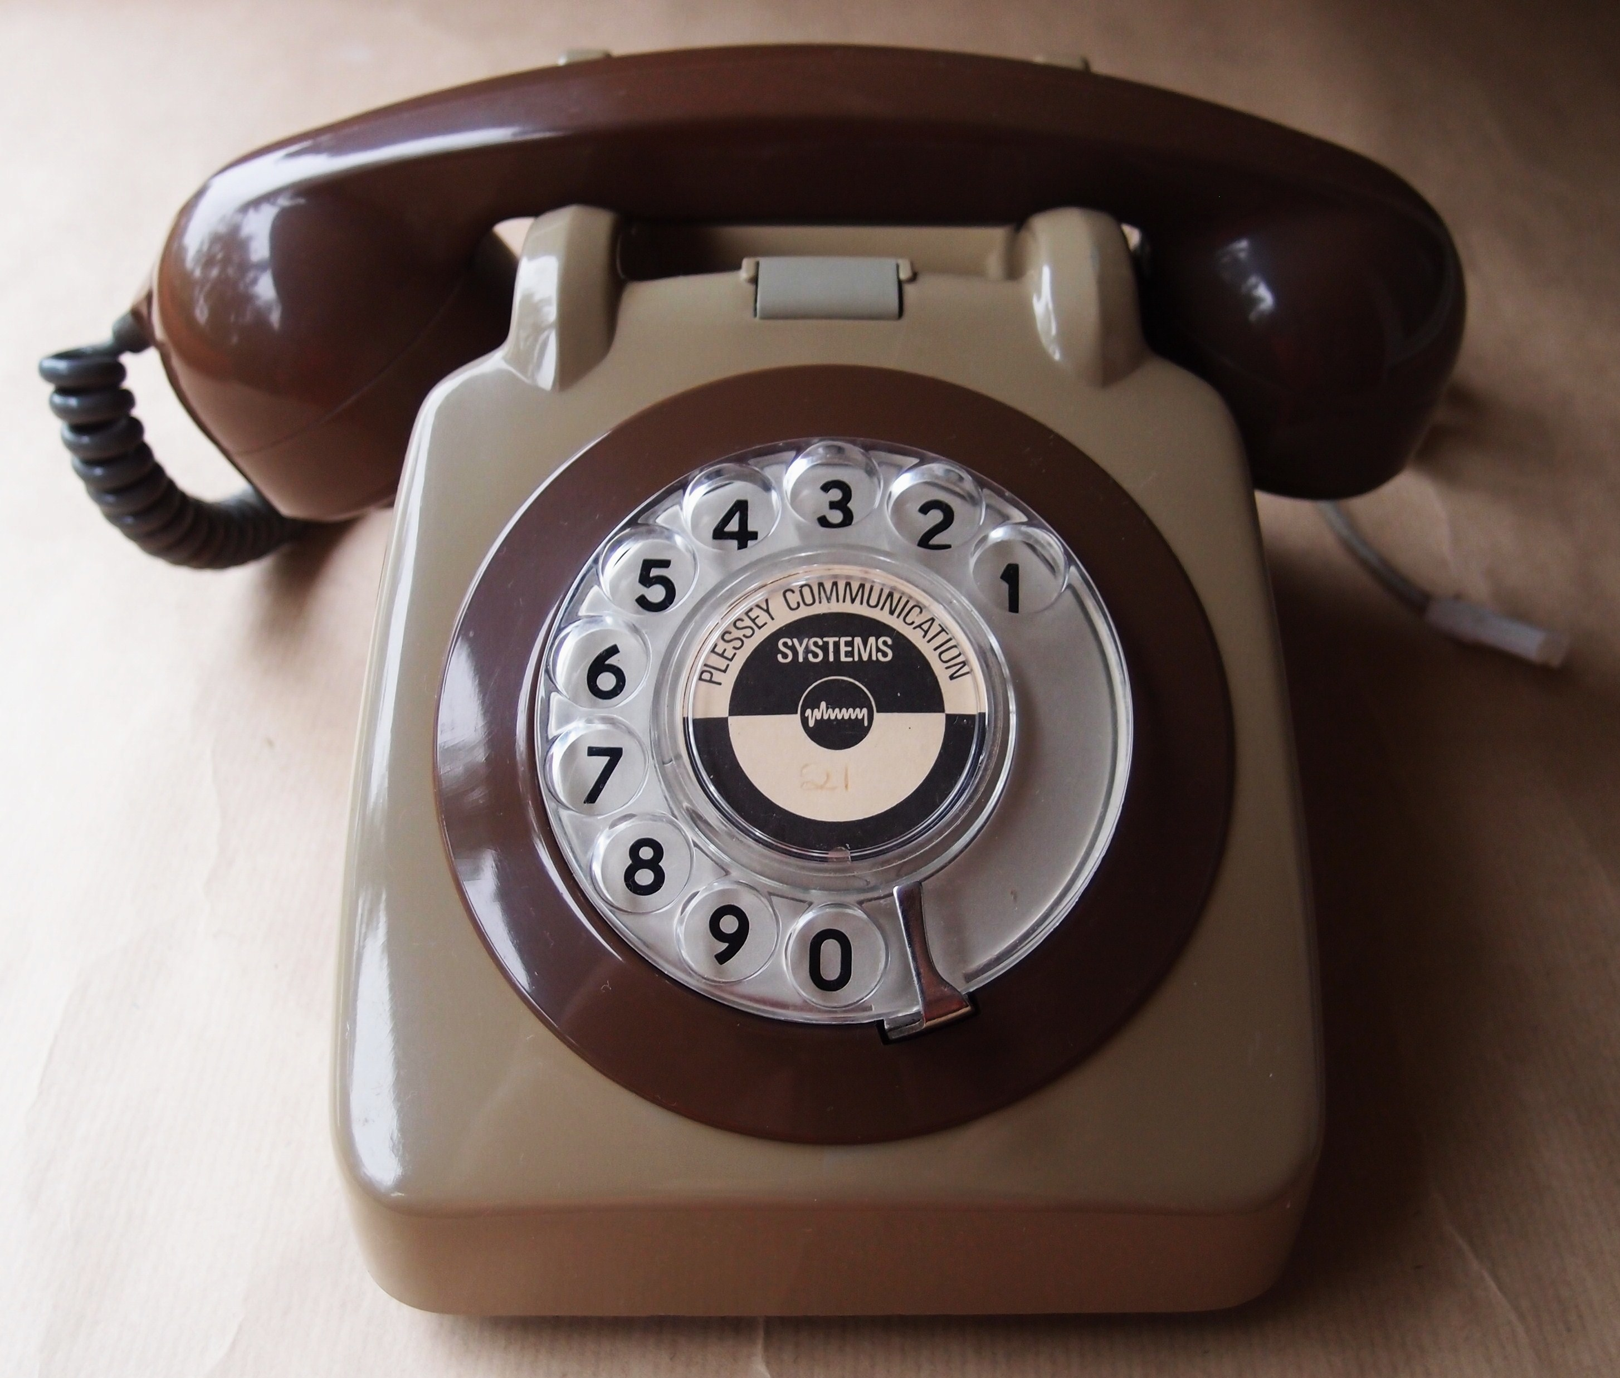
Evolution in action!
Let’s play Telephone

Slide 10
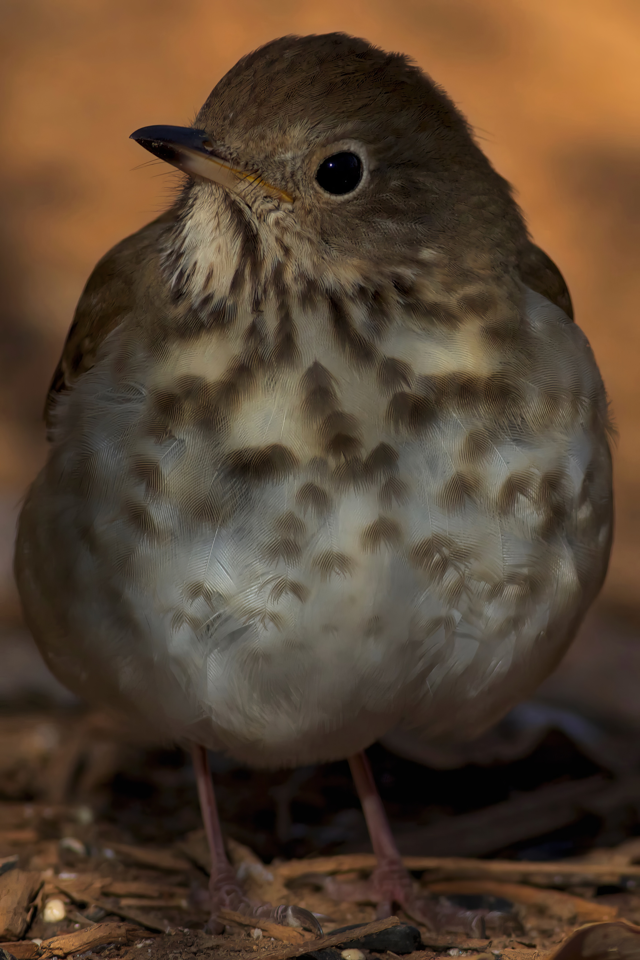
Conclusion
Metaphor in science as an inspiration for metaphor in education:
  Cultural evolution is an advanced topic by itself but provides ways to introduce children to evolutionary processes
Electronics and computational development allows low-cost activities that can allow children to play hands-on role in citizen science research

