Slide 1
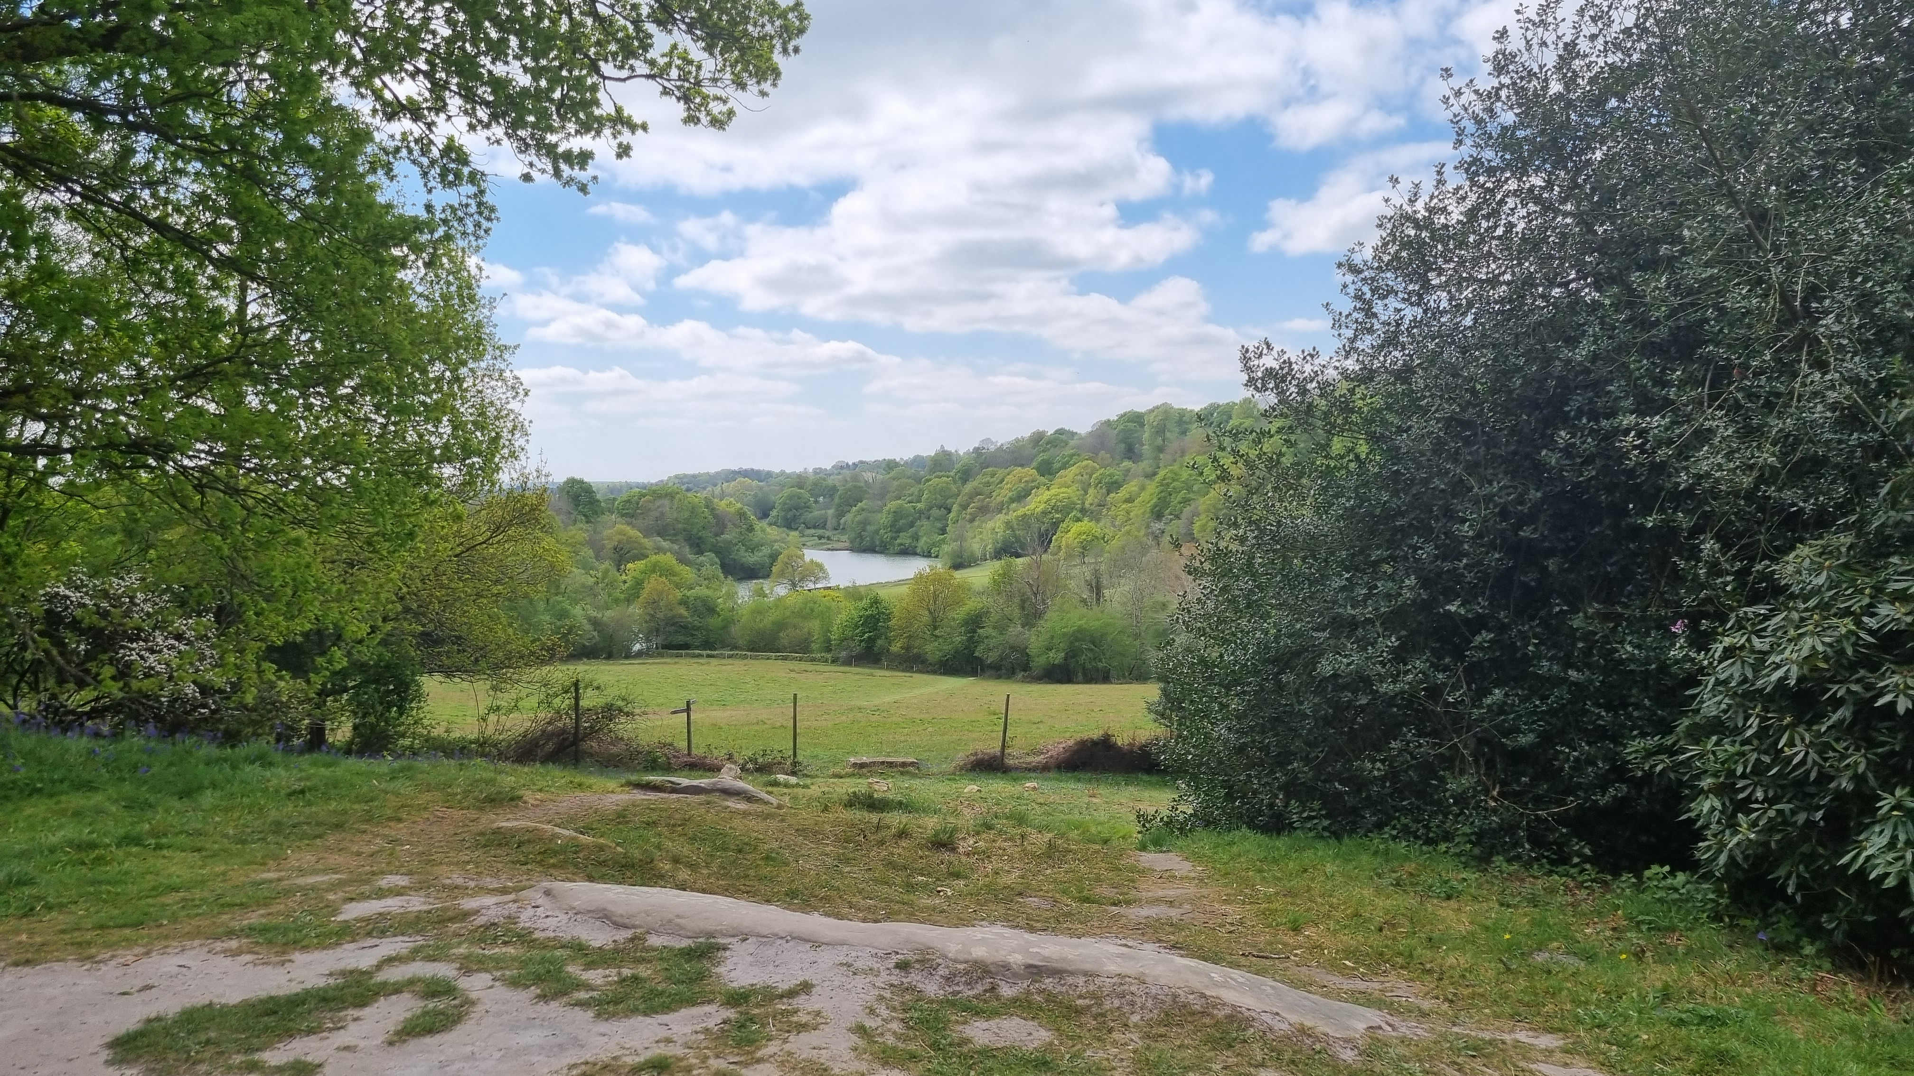

Noticing nature – linking nature with wellbeing
Dawn.Watling@rhul.ac.uk
@Dawn_Watling

Slide 2

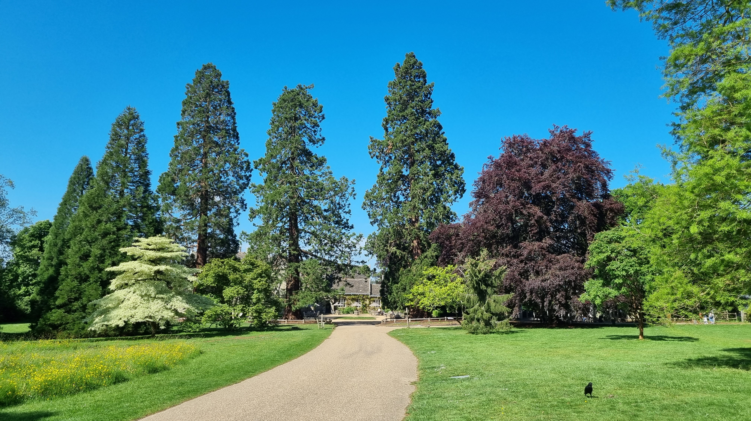
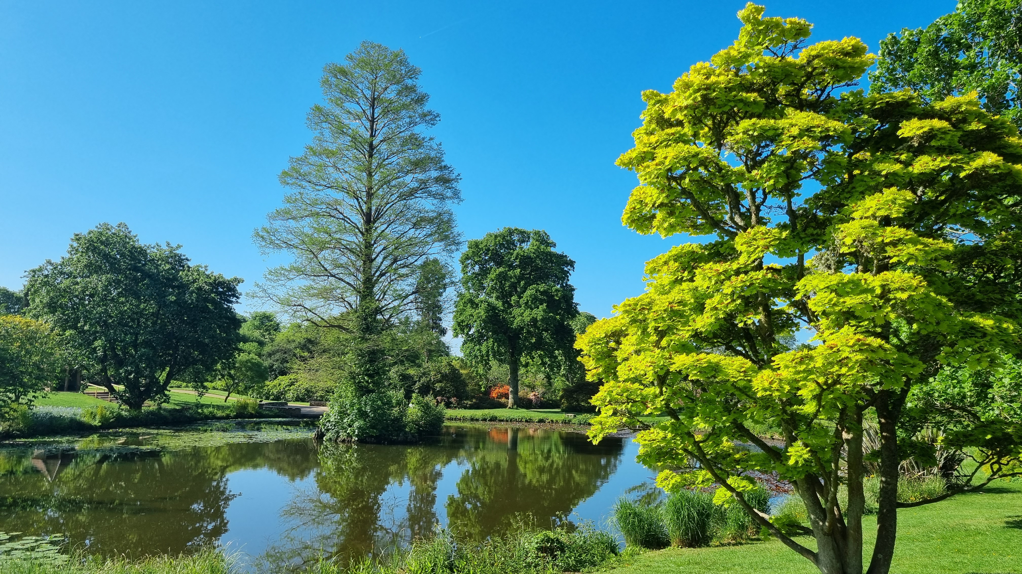
Why explore connection to nature?
Global societal challenge
1 in 5 sixteen+ year olds experience symptoms of anxiety and depression
10% of 5- to 16-year-olds have a clinically diagnosable mental health condition
Wellbeing declines between 10-12 years
Children with anxiety disorders are unlikely to access support services.
1 in 5 access mental health services
Spending time in nature is associated with physical fitness, learning and attention, wellbeing & mental health.
Social prescribing nature?

Slide 3
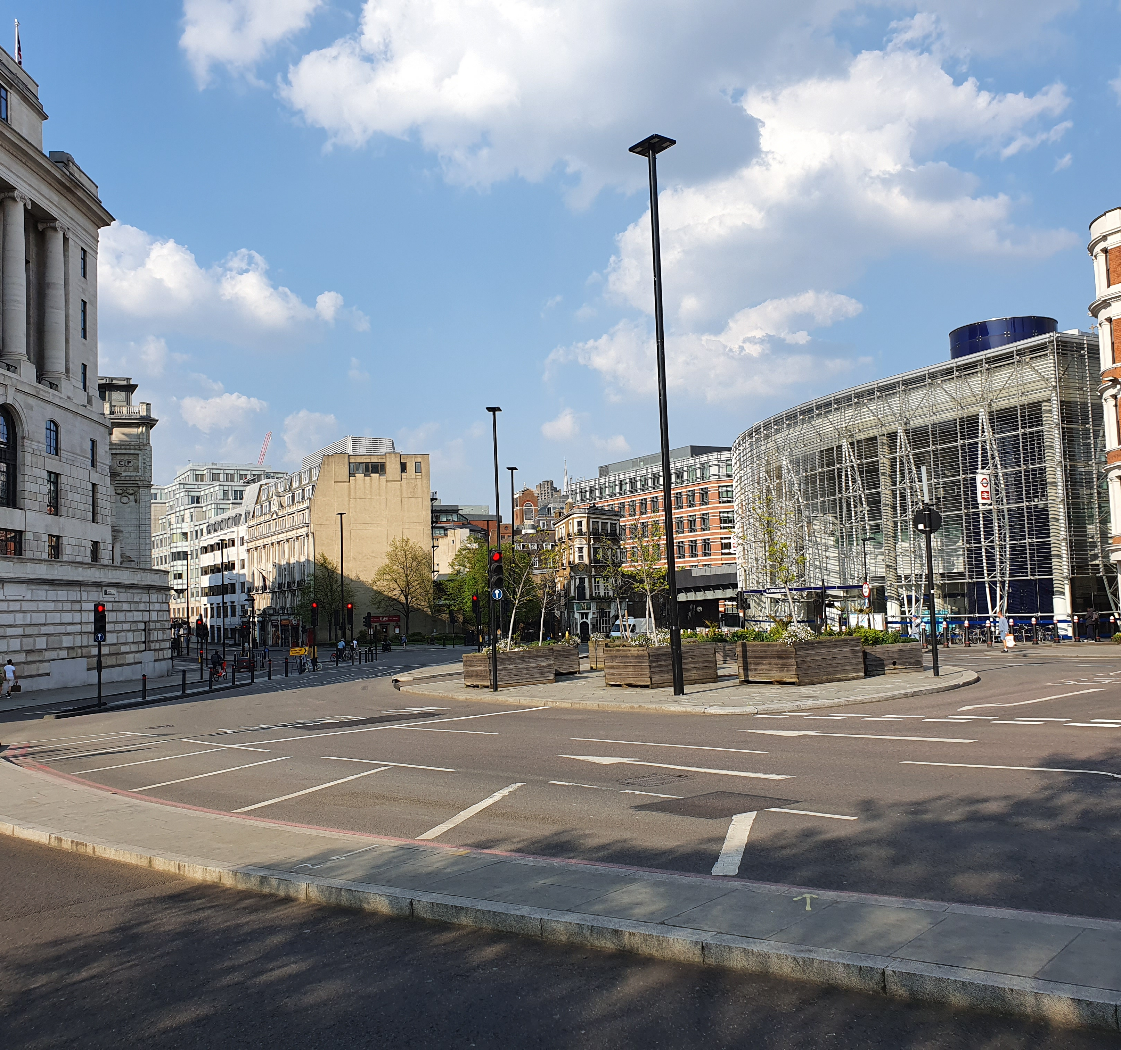
Reports indicate that 90% of UK population is in urban environments and that children growing up in urban environments are less likely to enjoy the natural environment, have less contact with green areas and native wildlife.

Slide 4
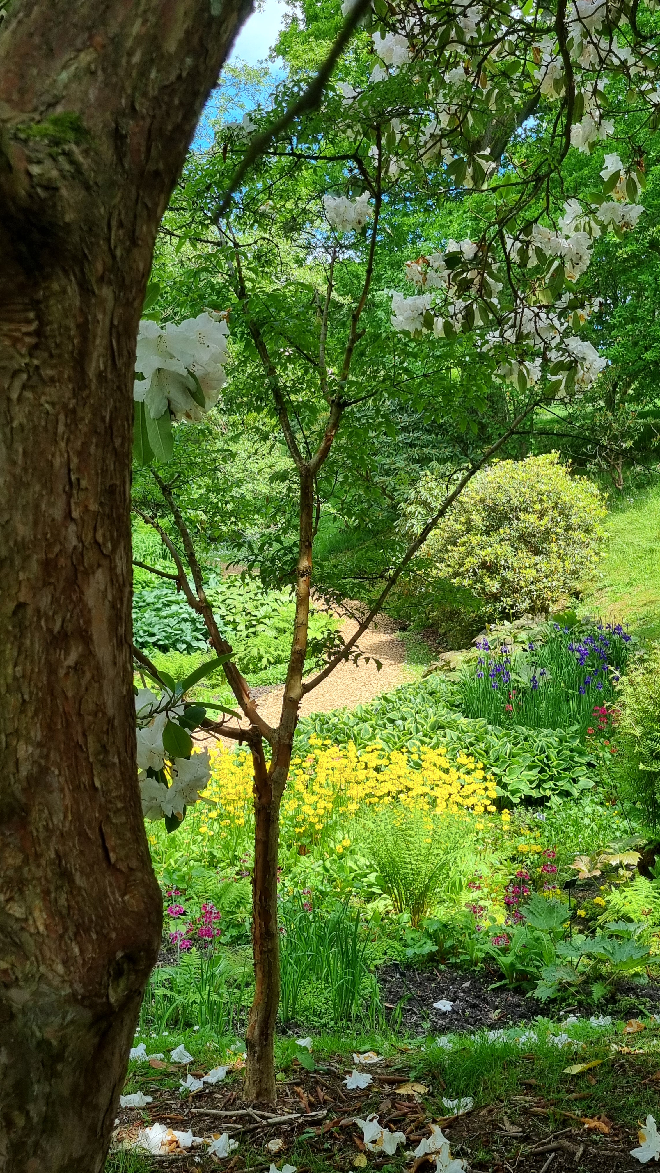
Past work has shown us …
Evaluation of a hands-on engagement in 21-week nature engagement programme
With >500 child participants, we found positive increases in mood, wellbeing, resiliency & connection to nature.
  Mood, wellbeing, and connection to nature; improvements in particular for those initially low in connection to nature (Harvey et al., 2020)
  Perceptions of biodiversity, which is associated with improvements in wellbeing (especially when perceived greater trees and fewer insects than existed over time) and resilience (when perceived greater number of invertebrates and animals over time; Montgomery et al., 2022).
Notes:
Benefits of playing outdoor sport vs indoor
Benefits for learning and engagement

Slide 5
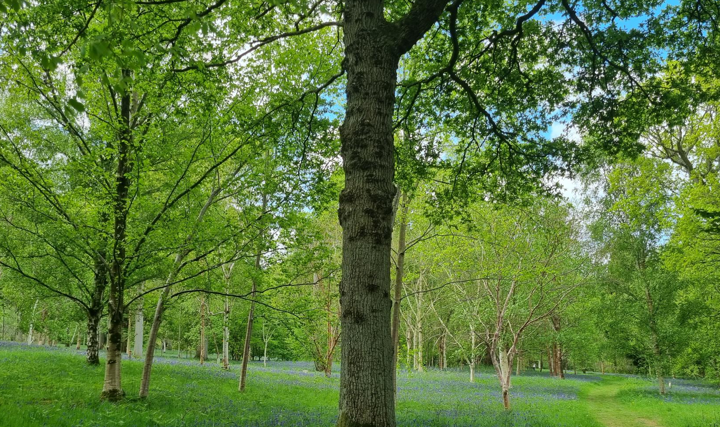

Research Collaboration
Exploring role of engaging in biodiverse landscapes on connectedness to nature, mental health and wellbeing
Notes:
A construct that describes an individual’s sense of their relationship with the natural world.
Nature connectedness goes beyond simple contact with nature, creating a new relationship with nature by working towards a sustainable future.

Slide 6
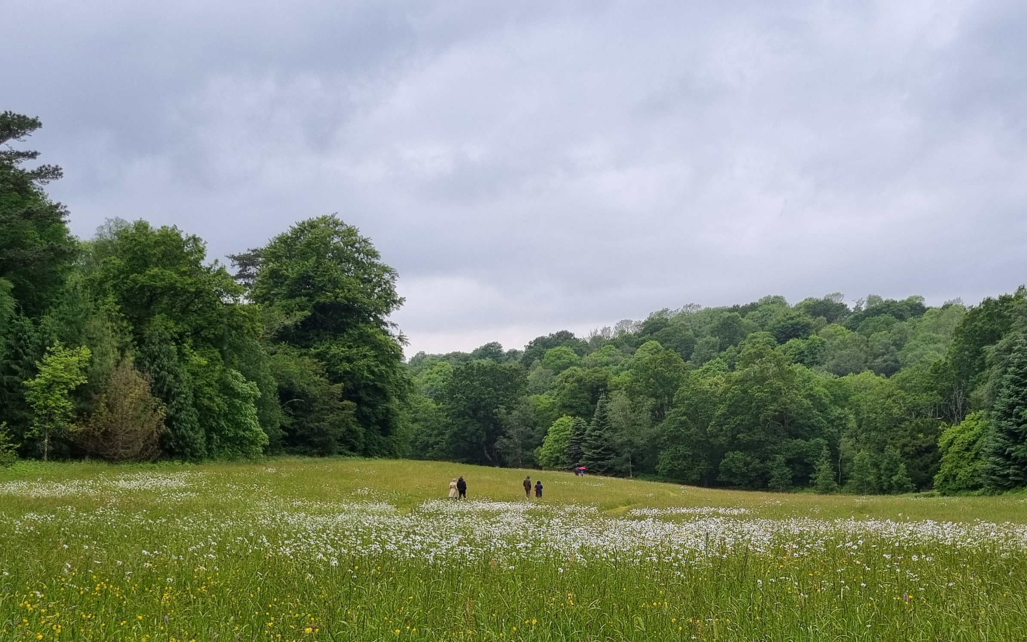
Nature Connectedness describes an individual’s sense of their relationship with the natural world.

Slide 7
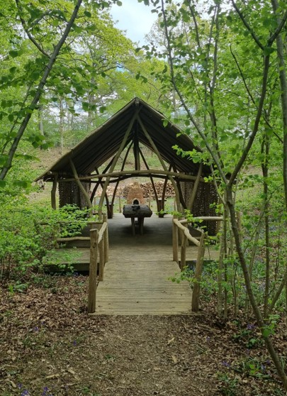
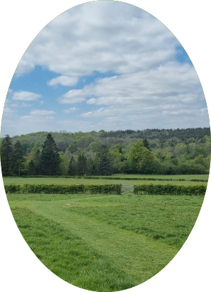
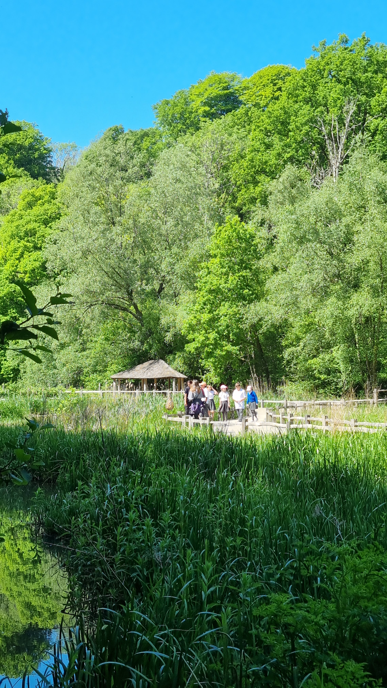
Environment you spend time in may matter…
WETLANDS
Wetlands Boardwalk
WOODLANDS
Pearcelands Wood
MEADOW
Corination Meadow
Notes:
LORRAINE: The groups each visited three biodiverse landscapes May – July.

Slide 8
Outdoor engagement: Reports from 599 young people
Percent reporting frequency of spending time playing outdoors |  | Percent reporting frequency of visiting parks |  | Percent reporting levels of satisfaction with amount of time spent outdoors.
30% | Every day | 9% | Every day | 28% | Would like to spend a lot more time outdoors
29% | Most days (4-6 days per week) | 16% | Most days (4-6 days per week) | 24% | Would like to spend more time outdoors
26% | Some days (2-3 days per week) | 29% | Some days (2-3 days per week) | 43% | Spends the perfect amount of time outdoors
8% | Not very often (1 day per week) | 21% | Not very often (1 day per week) | 3% | Would like to spend less time outdoors
5% | Rarely (couple days per month) | 22% | Rarely (couple days per month) | 3% | Would like to spend a lot less time outdoors
2% | Never | 4% | Never

Slide 9
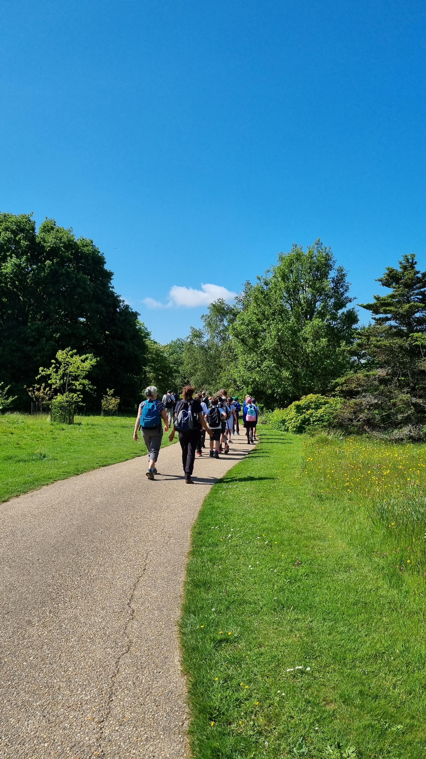
Greater C2N
R² = 36%
↑ Anxiety post walk
Habitat visited (meadows)
↓ Age
↑ wellbeing & improvements during visit
↓ pre-visit C2N
Greater wellbeing
R² = 50%
↓ pre-visit wellbeing
↑ C2N & improvements during visit
↓ in anxiety & depressive symptoms & improvements during visit

Slide 10
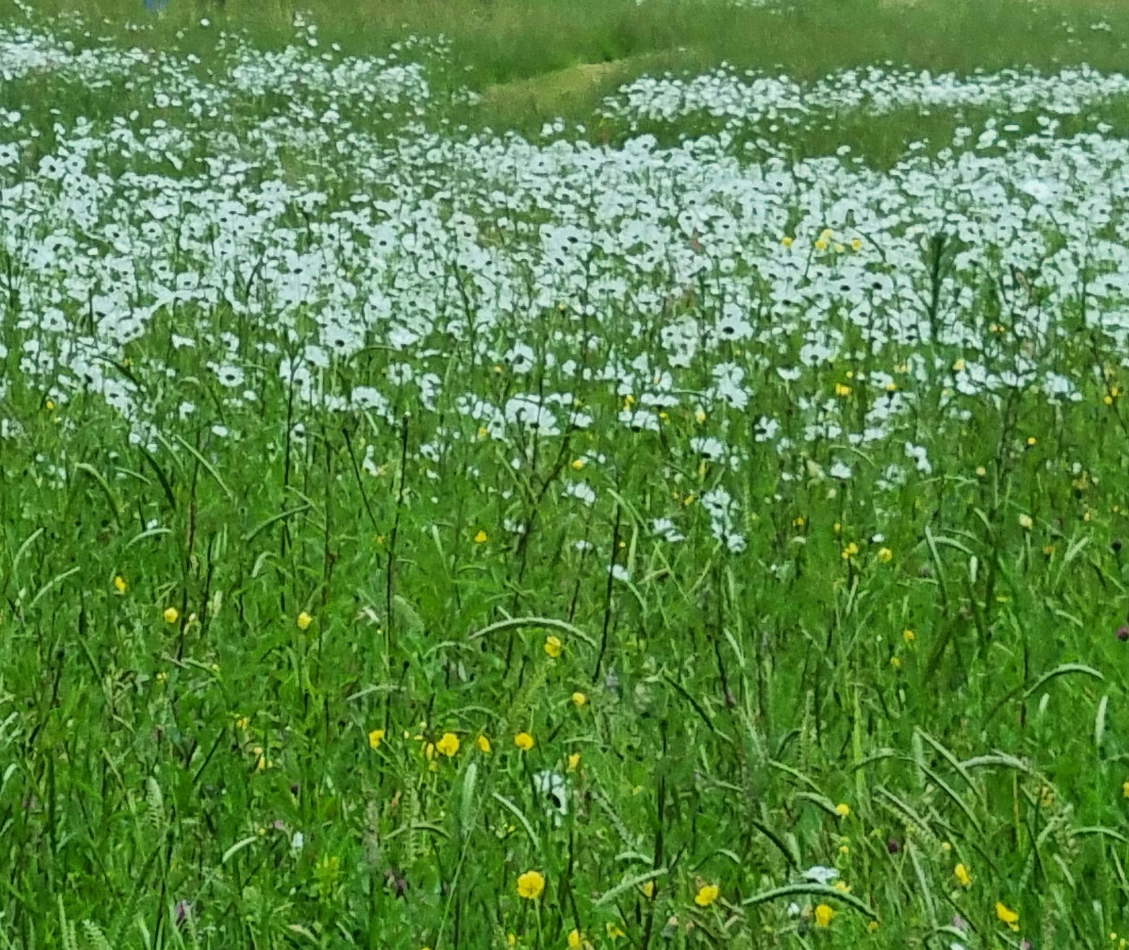


Thank you for listening
Acknowledgements
Thank you to my funders and research collaborators:
Lorraine Lecourtois, Adnan Levent, Ryan Jefferies, & Aysha Bellamy
Dawn.Watling@rhul.ac.uk
@Dawn_Watling

Slide 11
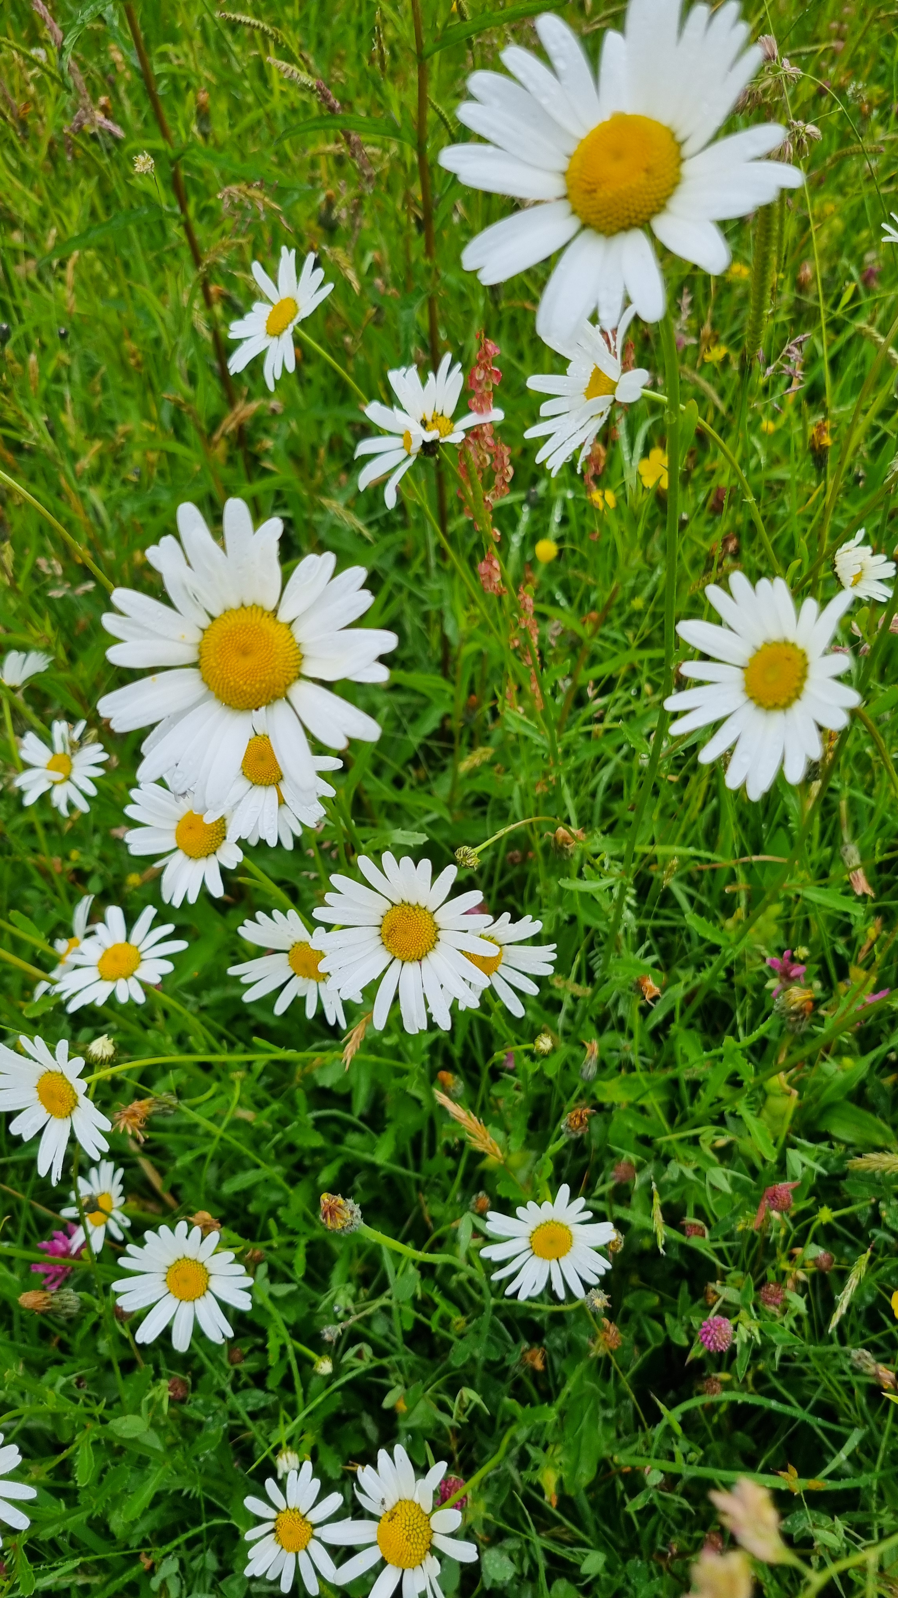
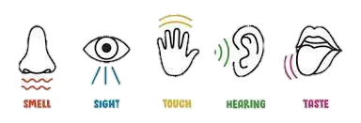
Use your 5 senses and take time to reflect on what you notice.
If you close your eyes, do you notice anything different?

