Slide 1
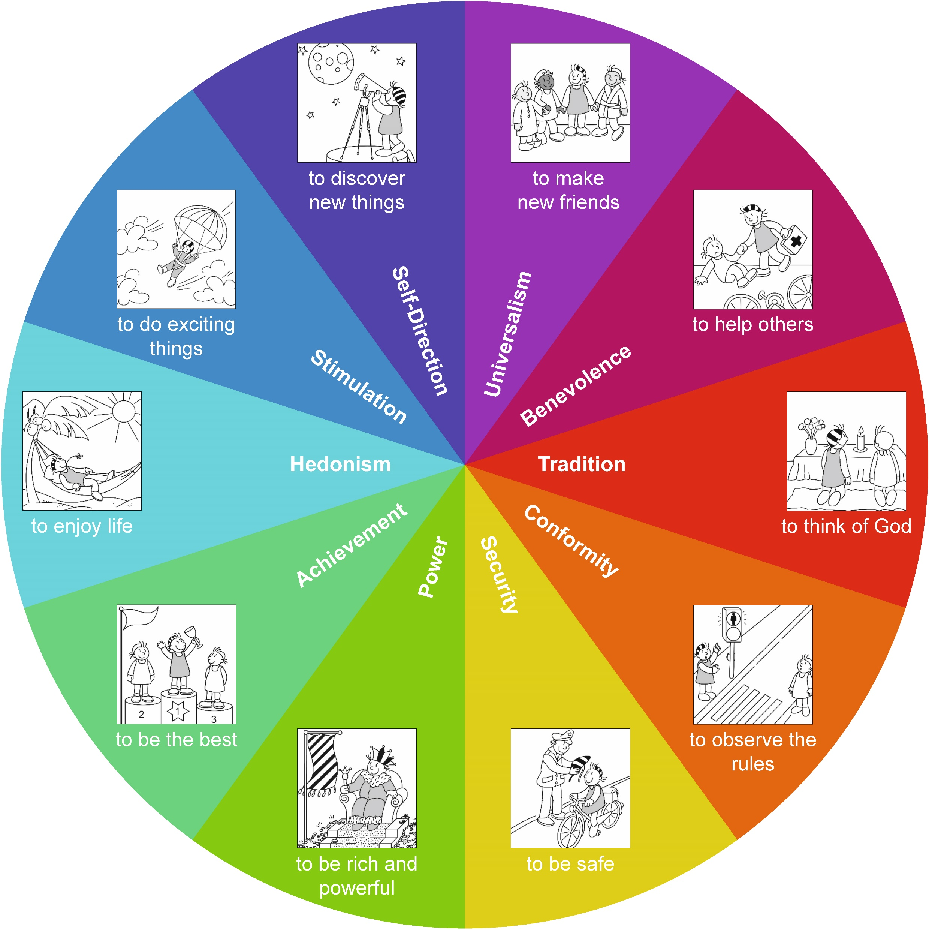
How can teachers use personal values in the classroom to encourage value development in children? Lessons from the VALISE project
Seeing teacher as warm? Later increase in kindness values and decrease in self-enhancement values
From start of primary school over 1.5 years: Kindness and openness values increase, self-enhancement & conservation decrease
Openness to change
Kindness
Feeling close to teacher? Later increase in conservation values and decrease in openness to change values
Children tend to act according to their values
Conservation
Classmates have strongest effects: Children’s values become more like their classmates’
Self-enhancement
In early primary school, values follow behaviour
In the workshop:
What’s important to you?
How do you act by it in class?
How do you ensure you don’t encourage the opposite values?
Same w children, lesson plan & worksheet provided
Your explanation to our findings?
Notes:
1.5 years from beginning primary school every 3-4months 1000students. Children’s Warmth perceptions of teacher support, encouragement, and acceptance, i.e., whether the child feels cared for and valued, (i.e., My teacher “says nice things about my work”, “tells me I am smart”, “likes me”, “smiles a lot”). linear increase in openness to change values (hedonism, stimulation, and self-direction), indicating that these values showed a steady and constant increase over time, where the rate of increase remained the same (for results and visualization, see Table 2 and Figure 3). The results also revealed a quadratic increase in self-transcendence values (universalism and benevolence), suggesting that these values were increasing over time (positive time term), but since the time-squared term was negative, it also indicated that the rate of growth initially accelerated but then decelerated over time. Further, and as hypothesized (H1b), we found quadratic decrease in self-enhancement values (power and achievement), indicating that these values were decreasing over time, and the rate of growth initially decelerated but then accelerated over time. Lastly, conservation values (tradition, conformity, and security) showed a quadratic increase, followed by a quadratic decrease, suggesting a pattern of growth where the initial growth is positive but decelerating, then reaching a plateau and eventually leading to a peak followed by a decline in the growth rate

