Slide 1




Making the most of digital approaches to mental health and wellbeing in schools
20th June 2024 Professor Helen Pote h.pote@rhul.ac.uk
Notes:
Thank you Andy for that kind and generous introduction and to everyone for joining me here today to celebrate.
A particular welcome to NHS colleagues and friends who are joining from across London and beyond.

Slide 2

Digital Mental Health in Schools
Mental Health of young people
Why schools might help
EdTech & digital mental health interventions
Two examples from RHUL
Barriers and facilitators to using digital mental health tools in schools
www.digitalhealthskills.com

Slide 3
Youth mental health problems are on the rise
NHS Digital
2023
£7%
1 in 9
1 in 5
8-25yrs
Notes:
I don’t need to remind you you will see it in your classrooms. Doubled in the last 5 years according to the best estimates we have from Survey NHS Digital 2023 for younger and older children. Tracked 2,370 young people over time. Percentage of CYP with a probable mental health disorder in England 217-2023. Strengths & Difficulties Questionaire + algorithm
Rates gone up from about 10-20%, Such that One in five pupils in every classroom has a probable mental health disorder (up from one in nine in 2017. Rates remaining stable 2022-3
One in five children and young people in England aged eight to 25 had a probable mental disorder in 2023,
We don’t know why it is increasing but obviously while the gender balance is the same for the under sixteens in the 17 to 25 year olds, rates were twice as high for young women than young men, with high rates of anxiety, self-harm and eating disorders a particular concern you will have likely noticed in the classroom.
We don’t know why it is increasing but obviously in this time there has been COVID, cost of living crises, limited access to mental health treatment and despite 7% increases in youth mental health services identified centrally funding has not been traditionally ringfenced nationally leading = leading to local inequities (average spend per child by NHS £34-141) & funding is not keeping pace with demand. YP report being worried about money, climate change and their physical/mental health. There is a bit of hope 2022-3 figures are levelling off.
So of those kids with MHP only 1/3 get treatment = 34%
53% of young people are seeking help elsewhere not GP…
6-16yrs 17-19yrs
2017 11.6 10.1
2021 17.4 17.4
2023 20.3 23.3

Slide 4
Young people with mental health problems are having a hard time in school…
5x more likely to have been bullied in-person or online
3x more likely to find extra-curriculars or socialising with friends unaffordable
Compared to peers without mental health problems
NHS Digital, 2023
Notes:
Compared to peers without mental health problems
So in addition to their men
5x more likely to have been bullied in-person or online
3x more likely to find extra-curriculars or socialising with friends unaffordable, cant afford the right clothes or equipment. Almost wice as likely to be worried about money have a parent who was worried about money.
Over 10 times more likely to be self-harming
Less likely to have a friend they can turn to ‘ feel safe in school, or enjoy learning
Those with MHP are a vulnerable and socially isolated and potentially economically deprived group of young people who schools need to support.
to have at least one friend they could turn to for support at school (75.3% compared with 92.4%)
•feel safe when at school (56.3% compared with 85.1%)
•be themselves at school (49.1% compared with 84.6%)
•to enjoy learning at school (35.2% compared with 70.9%)

Slide 5
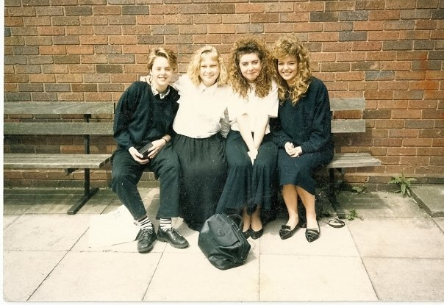
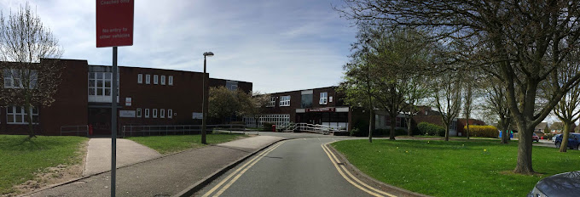
What is a school?
What type of school did you attend?
How much did you enjoy learning?
How much did you enjoy the social side of school?
How connected did you feel to the school as a community?
What do remember about the school’s provision for social, emotional and mental health needs?
HOW have these experiences shaped your views about the ways mental health support might be provided in school?
Notes:
Despite this bleak picture around service provision. We should not stop innovating and one of the ways this is happening in health and adult mental health services is regarding digital innovation of interventions. This will be the topic of my talk – lts go back to basics and pause a moment
What is a school? What are its functions? What were or are your experiences of school
Here Is my comprehensive in Great Wyrley in Staffordshire… and with my friends circa 1987
?
This seems a strange question to ask a room full of educational practitioners with far more experience of schools than me but I want you to just reflect for a moment how might mental health support fit into your image of a school… ask the questions. What were the needs when you were at school, how were they met and what are the needs now?
Invite any comments from the audience

Slide 6

Can schools support mental health?
Schools are …
“an immersive social experience as well as centres of learning, and can support the development of good social, emotional and mental health. Schools have the potential to offer a nurturing and protective environment for CYP in the most adverse circumstances”
Picciotto, Hickey & Barnet (2024)
Notes:
Let us think about why schools might be a good environment to support mental health. Schools are …
“an immersive social experience as well as centres of learning, and can support the development of good social, emotional and mental health. Schools have the potential to offer a nurturing and protective environment for CYP in the most adverse circumstances”
Group of psychologists working within schools in London for 20 years have just written an excellent chapter about supporting mental health in schools in this forthcoming book published by Wiley out next month… shameless plug out of the way early – available on Amazon and all good bookshops
The government certainly think schools are a positive place to support mental health of CYP and a number of policies have pushed this agenda strongly.

Slide 7
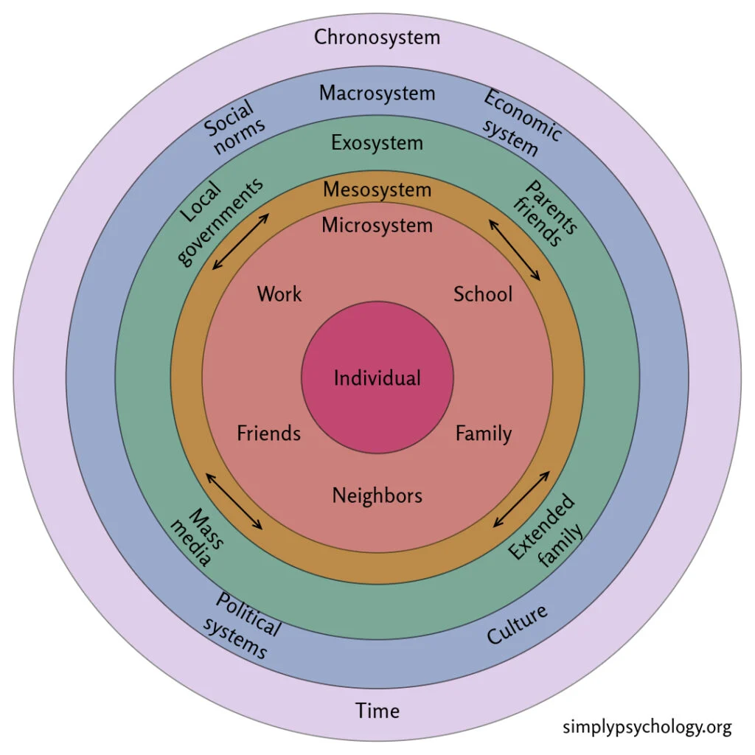
Child Mental Health: Complex ecosystems of risk and protective factors
Bronfenbrenner’s Ecological
Systems Theory (1979)
Notes:
BUT The influence of schools and teachers only form one part of a complex ecosystem of risk and protective factors for child mental health. Theories proposed by Bronfenbrenner & Morris, 2007 – ecological systems theory – describe this complexity. With schools playing just one important part – interlinked with other important micro-systems and influences.
Simplistic policy or understanding of mental health can be damaging, especially if too much responsibility is placed on schools due to dwindling
Mental health interventions in schools need to be understood as part of the whole ecosystem and risk factors and these attended to for a holistic effective approach to child mental health to be developed. The digital interventions I will describe today form a small part of that ecosystem.
Some risks for poor child health and educational outcomes do not originate in schools, but schools can buffer or exacerbate their effects e.g. family socio-economic deprivation known to be a risk factor for a range of educational and health outcomes can be alleviated to some extent by the provision of and we saw the opposite to this during COVID when such school buffers such as free school meals, access to IT and reading resources, access to open spaces were not available and led to greater developmental barriers and worse educational and health outcomes for young people from low SES families. Blundell et al. 2022)

Slide 8

Mental health & psychological interventions in schools
A long history of various practitioners supporting mental health in schools
  Teachers
  Special educational needs co-ordinators
  Counsellors
  Educational Psychologists
  Clinical Psychologists
  Education Mental Health Practitioners
Work spans the health and education systems
The core task of any school – learning and development – may not always align with the mental health and wellbeing needs of the child
Notes:
A long history of mental health support in schools promoted recently by health and education policy.

Slide 9

Mentally Health Schools - 8 Principles (2021)
an ethos and environment of respect, valuing diversity
leadership and management champions promotion emotional health and wellbeing
staff development to support their pupils/own wellbeing
curriculum teaching and learning to promote resilience and support social and emotional learning
enabling student voice to influence decisions
identifying the need for and monitoring the impact of interventions
targeted support and appropriate referral
working with parents and carers
Notes:
All of this has been principally replicating a universal approach to wellbeing + some targeted one to one support for kids in post needs

Slide 10
What does mental health support in schools look like?
What is your image of how we should support young people with their mental health needs in schools?
Does it involve in-person support from adult to child, peer to peer?
Does it involve digital support (an app, an online session, a computer game) as a supportive option for young people ?
Why not?
Notes:
What does mental health support in schools look like?
Maybe we need to think about what mental health in schools might look like if it was designed in 2023?
Given this context reflect for a moment on the following questions
Why not, when these socially isolated young people who have limited access to resources might find it difficult to access usual in-person psychological services.
Why are we not considering digital interventions that draw on technological advances?

Slide 11
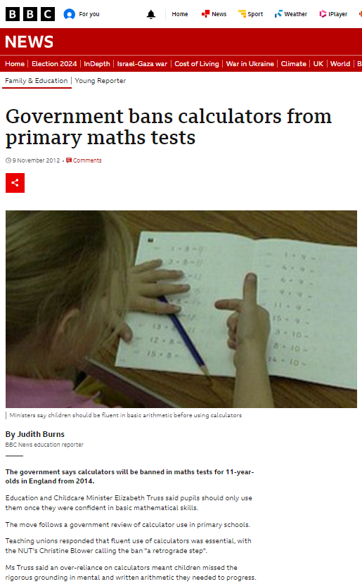
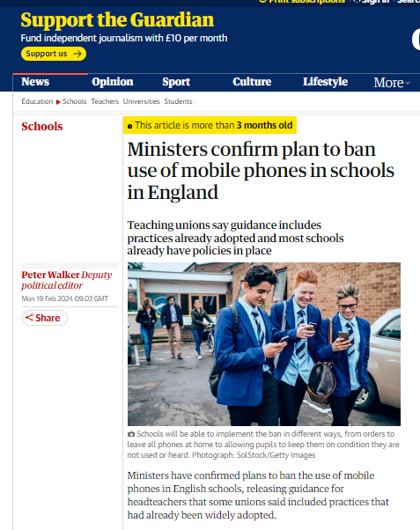
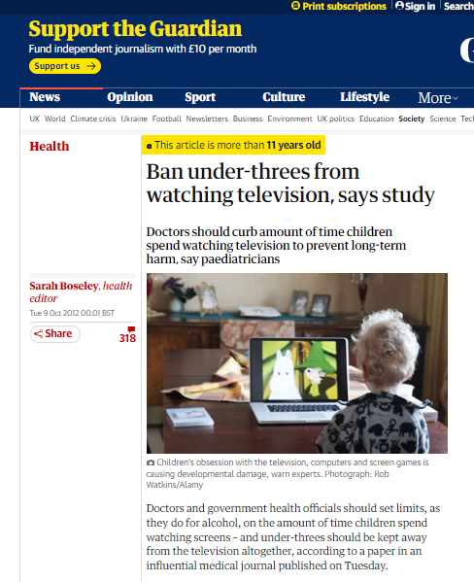
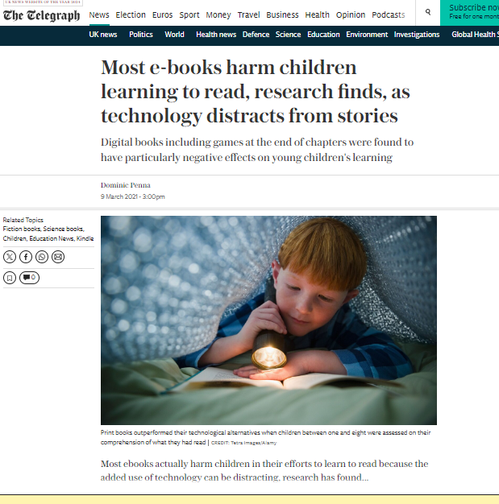
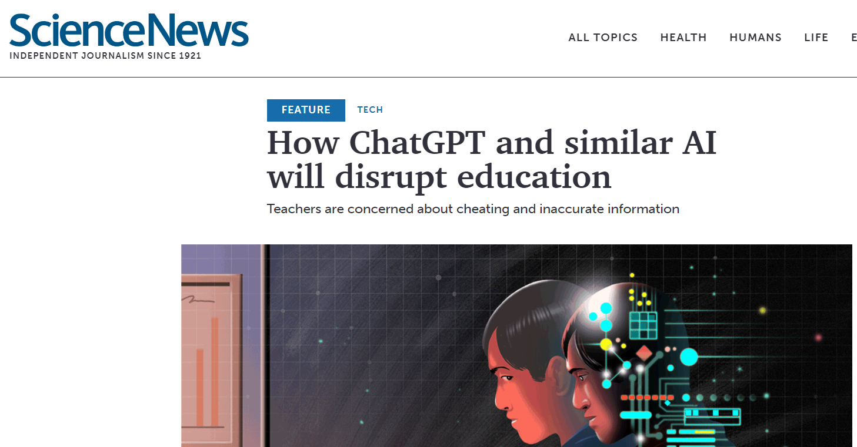
Anxiety that technology is bad for kids is not new…
Calculators
TV
Ebooks
Computers
Phones
AI
Notes:
One reason we don’t think about digital support for young people who are struggling with their wellbeing or mental health might be a long standing anxiety of the impact of digital tolls on young people’s learning and development. This often leads to knee jerk reactions to Ban technology at a policy level based on very partial evidence. My observation is that in the long term none of the bans work and technology always gets implemented/used by young people… it is important that we adapt our practice.
A note on AI though it is not the focus of the talk today it has been in the media a lot recently… 1/3 of young people are using AI to learn information!
In the Ofcom 2024 Children’s and Parents’ (CaP) Media Literacy Tracker survey of 3000+ young people 3-17yr olds – social media use and attitudes report (2024)
• Nearly half of children have used artificial intelligence technology, and they are twice as likely as adults to have done so: 46% of children aged 8-17 (46%) say they have ever used AI, and this is driven by the teenagers in this cohort (52%, and 59% of 12-15s and 16-17s, compared to a third (33%) of 8-11s). Children this age are more than twice as likely as adults to say they have used AI (46% vs 23%). Over a third of these 8-17-year-olds used AI technology either for fun (45%), to learn (35%) or for school work (37%). Perhaps we need to follow their lead and see how AI can be used to learn and support young people.
So let us think know how we can harness digital approaches to support young people -

Slide 12
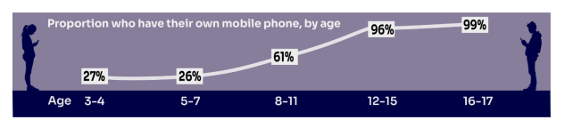
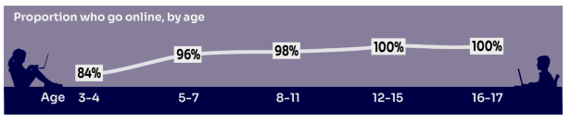
Youth Digital access – phones and online
Ofcom 2024
Notes:
What is the current state of play for digital use by young people?
In the Ofcom 2024 Children’s and Parents’ (CaP) Media Literacy Tracker survey of 3000+ young people 3-17yr olds (N=3383) – social media use and attitudes report (2024)
Parents report Increasing amounts of primary and secondary school children own their own phones and go online.
Look at the pre-school data here – almost 1/3 own their own phone
And the vast majority (84%) access online resources.
WE cannot pretend it is not happening. Supervision rates vary. Reminds me of when my 3 year old daughter ordered a set of Sylvanian families independently using Amazon one-click

Slide 13
Harnessing the power of digital for mental health in schools
We cannot ignore it - Digital influences are an important part of a child’s ecosystem/culture
It influences their developmental, educational and health outcomes
Could be a more engaging way to improve mental health
Offers teachers evidence-based wellbeing information / interventions
Offers easy opportunities for monitoring wellbeing outcomes
What if we used technology for good
  Apps
  Psycho-education and elearning
  Simulation
  Serious games

Slide 14

What is digital mental health approach? eHealth
“A psychological digital approach is any practice which uses health technologies to enhance our work with organisations, networks, families, couples and individuals, to improve wellbeing”
Burbach & Pote (2021)
Notes:
Can we embrace this increasing use of technology for good?
Two similar approaches in health and education aimed at embracing technology to enhance health, wellbeing an education for young people and their systems – digital mental health (or eHealth) and EdTech

Slide 15

What is an education technology approach? EdTech
“The practice of using technology to support teaching and the effective day-to-day management of education institutions. It includes hardware (such as tablets, laptops or other digital devices), and digital resources, software and services that help aid teaching, meet specific needs, and help the daily running of education institutions (such as management information systems, information sharing platforms and communication tools).”
DfE, 2019
Notes:
Similarly

Slide 16
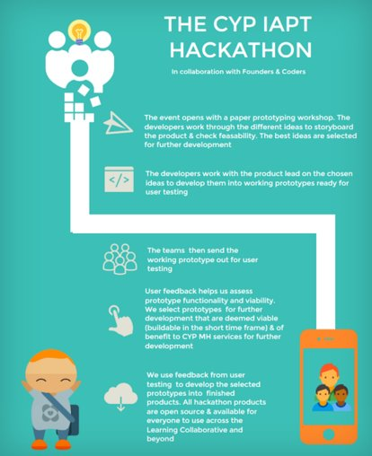
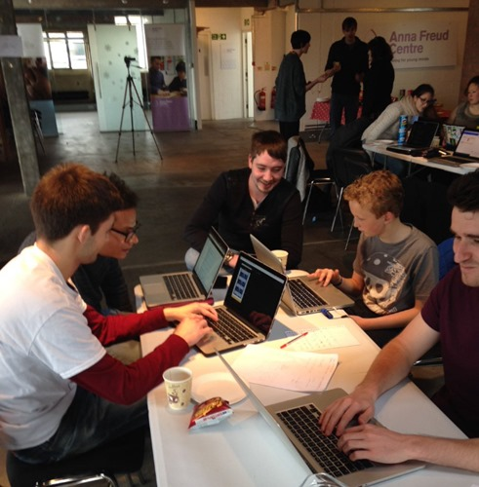
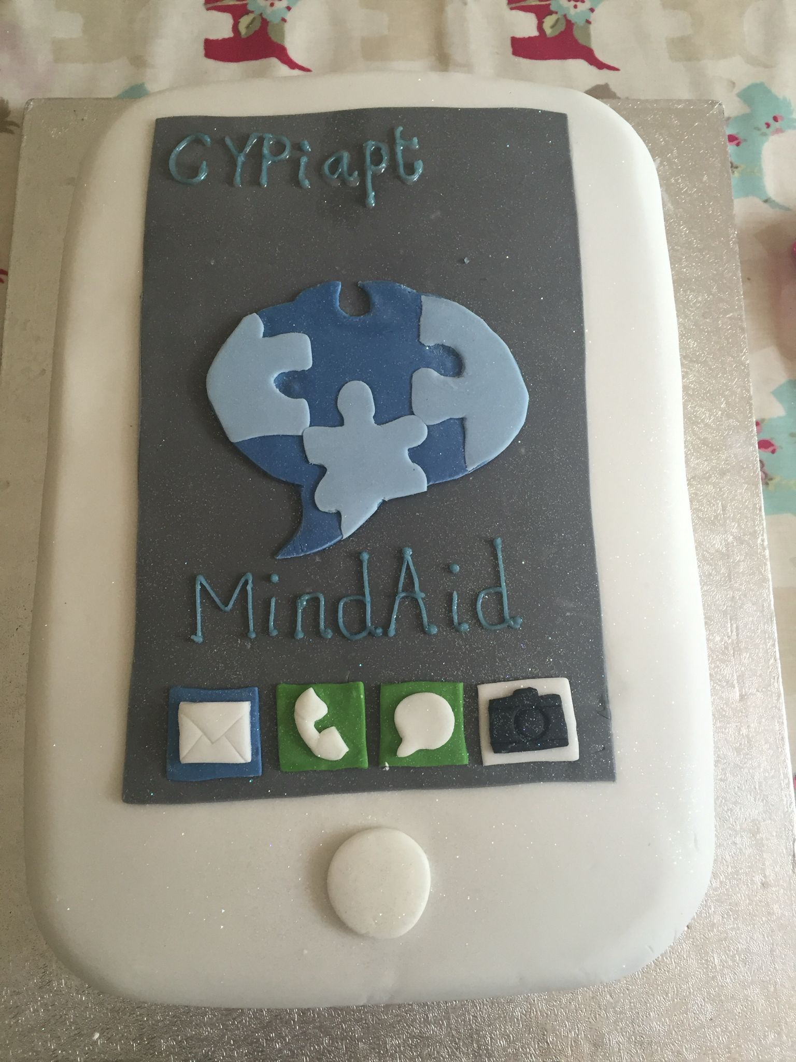
A Fortuitous Invitation: Hackathon
Notes:
I first got interested in applying digital approaches to mental health in schools about 10 years ago
In 2015 in this state of inactive anxiety I received a fortuitous invitation to a Children and Young People’ Mental Health Hackathon from a friend and colleague Duncan Law. The invitation said ‘I thought some of your trainees might be interested in this event at the Anna Freud Centre at the weekend…
It looked interesting, it looked digital, so I googled what on earth a Hackathon was - It is an intensive development event where software developers and experts on a topic meet together over a few days to create digital solutions to real world problems. In this case child mental health professionals, youth advisors with experience of mental health problems and coders from Founders and Coders
I invited trainees – fearful I did not have the correct expertise and sceptical about a digital approach – they were all busy, but I thought it was important so I went with my 10 year old gaming son, Billy, as a ‘digital crutch’ in case there were things I did not understand. The event totally blew my mind. The reach of digital methods and young people’s engagement with them made me question why we were still delivering psychological assessments and interventions
During the weekend developed a prototype of MINDAID a mental health first aid app for teachers and young people which we have been developing and trialing in UK schools since. I always like to celebrate events with a cake and her is the one I made for the event.
It opened my eyes to the value of digital solutions, how they were valued by young people and the language of a coders which was different to psychology but still about problem solving. I became convinced of the need to introduce digital skills development into the training agenda.

Slide 17
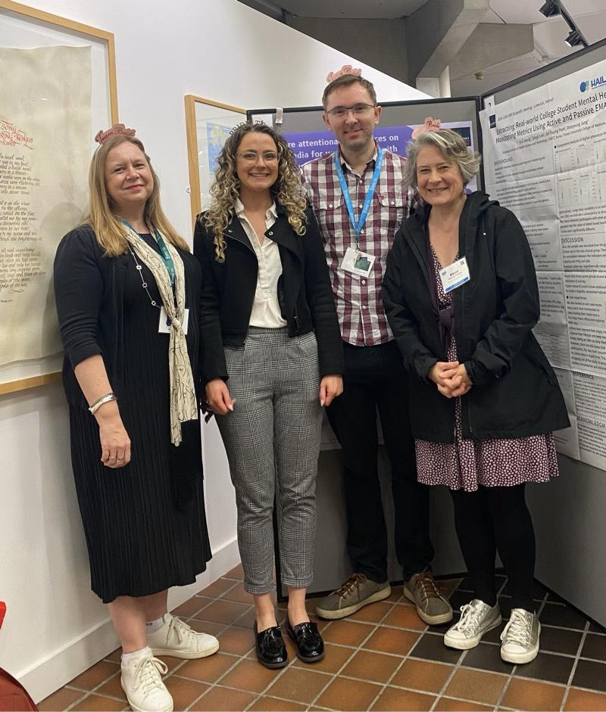



DCP National Digital Healthcare Committee
Our Mission
Supporting competent and confident applied
psychologists to deliver ethical digital practice
www.digitalhealthskills.com
Notes:
We started presenting at practitioner and research events. Now People were very interested in our work. Even the professional body. Psychologists, commissioners, tech companies, experts by experience all with experience of digital mental health interventions
Our working group was adopted by the British Psychology Society, Division of Clinical Psychology, Digital Healthcare Sub- Committee.
Our Mission
Supporting competent and confident applied psychologists to deliver ethical digital practice

Slide 18
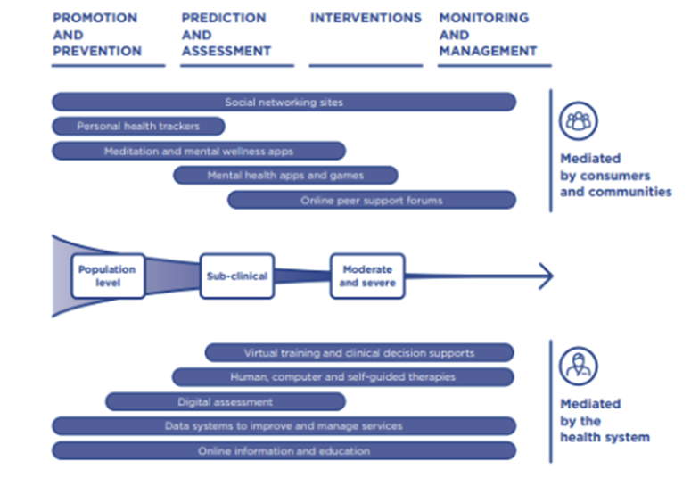
Digital approach across a range of needs/services
World Innovation Summit for Health Report (2020)
Notes:
Digital mental tools are being developed for adults young people for those without problems to those with more severe difficulties. Addressing health promotion, assessment to target need, intervention to improve problems and self management and monitoring.
Infact the World Innovation Summit for MHealth Report in 2020 offered a framework for understanding digital technologies in mental health. It was an important document which details the ways that digital mental health technologies will be used by the public and professionals, with digital interventions ranging from population level health promotion, through to individual prevention, assessment, and interventions, with follow up health maintenance
They named their report the Digital Mental Health Revolution but we have not really seen this revolutionary impact on NHS services across the UK yet. Why not? And importantly would we even want that?
(Roland et al., 2020, p.5).

Slide 19
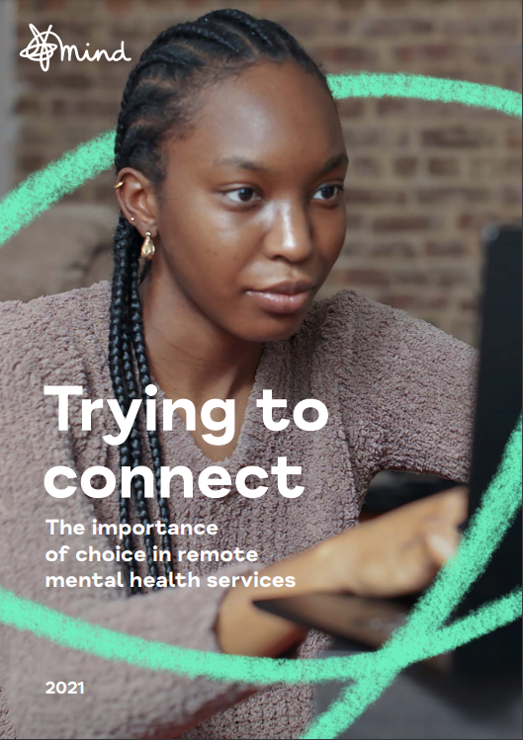
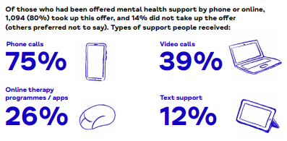
Digital Mental Health as a Choice
Notes:
Now there are many opportunities to access mental health interventions in Health settings for adults and children
COVID led to Many more people were offered online assessments and interventions - Mind conducted a survey of their experiences in 2021
Almost 2 thousand (N=1941) teenagers and adult participated 30% had received digital serves before pandemic
67% of the sample offered digital services during or after the first lockdown. They were receiving a mix of digital services but the majority were still reliant on phonecalls. It was a digital revolution but hardly the one predicted in government policy.
Let me just set out my stall here. I agree with MIND that digital services are not for everyone but should be a choice offered to clients, In the Trying to Connect Report they found 80% of clients took the digital service that was offered to them. 41% were offered in lockdown so we could argue they did not have a real choice.
Attending to Choice, Digital Inclusion and Exclusion is important if we are going to embrace a digital revolution.
Insert DCP Digital HealthCare committee digital inclusion paper 2024

Slide 20
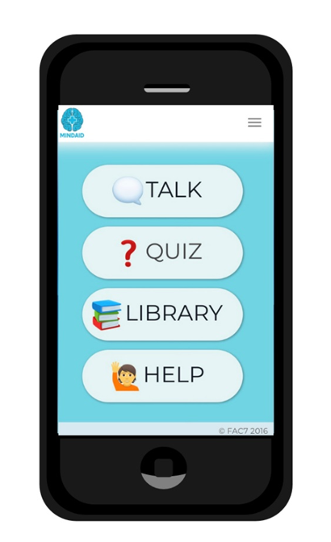

Example 1: Mental Health Literacy App
Notes:
Going to move onto 2 examples of digital mental health innovations we have co-produced with pupils, teachers and parents and trialled in school settings

Slide 21
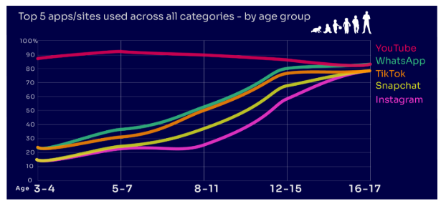
Young people like using apps
OfCom 2024
Notes:
N=3383 Parents of 3-17yr olds
OfCom 2024
42% using TikTok
YouTube is the most-used app or site among the children in our study, with more than eight in ten 3-
17-year-olds using it. However, while YouTube is a popular app across all age bands, some sites or
apps grow in popularity with age. For example, just under two in ten of all 3-4-year-olds use
Instagram and/or Snapchat (17% in each case) but this rises to eight in ten among 16-17s (for both
apps). Similarly, just under a quarter (23%) of all 3-4-year-olds use WhatsApp, and this rises to over
eight in ten (83%) of all 16-17-year-olds. This underlines the more interconnected and social nature
of older children’s online behaviours; indeed, half (49%) of all 16-17-year-olds use all five of the top
apps/sites (YouTube, WhatsApp, TikTok, Snapchat and Instagram).

Slide 22
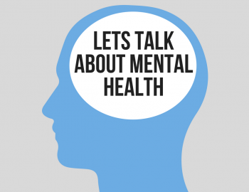
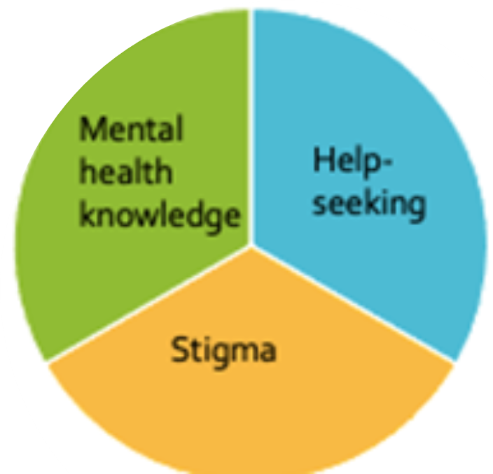
Mental Health Literacy
“Knowledge and beliefs about mental health difficulties which aid their recognition, management or prevention” Jorm, 1997, p.182.
Aims to address barriers to mental health help-seeking in youth
perceived stigma & embarrassment,
problems recognising symptoms
preference for self-help and informal support
Notes:
We wanted to develop and app which addressed low levels of mental health knowledge in youth and teachers. Community based approach to enhance peer support and support individuals to develop Knowledge and beliefs about mental health difficulties which aid their recognition, management or prevention in order that they can help others with early signs of distress
Mental health knowledge
Stigmatising attitudes
Help-seeking efficacy (intentions, attitudes, behaviour)
To address concerns about the prevalence of mental health difficulties in young people, interest in early intervention and prevention strategies has increased.
This includes increased funding for mental health services, encouraging schools to appoint mental health leads and mental health training for non-health professionals such as secondary school teachers, to identify and help those experiencing difficulties (Department of Health and Social Care and Department of Education, 2017).

Slide 23
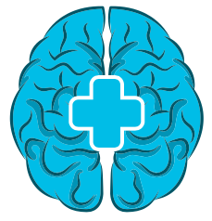

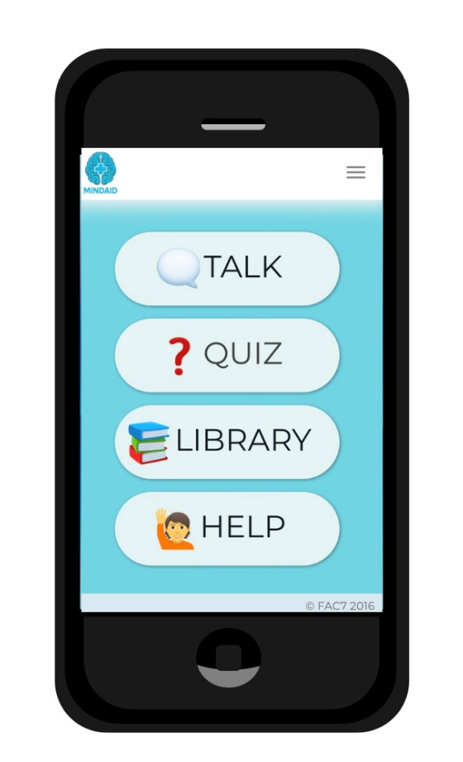
MINDAID YOUTH
www.mindaid.org
Mental Health Literacy App to a resource to support teachers and CYP to recognise and respond to mental health problems
  Talk: information and interactive exercises about how to ask for help, support friends and discuss worries.
  Quiz: quizzes to check-in with mental wellbeing, identify any difficulties and challenge mental health related stigma.
  Library: 12 modules about different aspects of mental health, getting help and initial self-help suggestions.
  Help: details of local organisations which can provide appropriate support (using GPS technology) and further self-help information.
Notes:
A free digital tool which has been designed with the aim of enhancing young people’s MHL in schools
Targets young people 11-18years
The content includes 4 sections, and overlaps with the UK Personal, social and health education curriculum
MindAid also has a teacher’s version to support adult-youth conversations about mental health
MindAid Youth has four sections which have been carefully considered and developed to incorporate all components of the MHL definition and interventions as defined by Jorm and colleagues (Jorm et al., 1997; Jorm, 2012).
‘Talk’ provides information and interactive exercises for young people about how to discuss worries, ask for help and support their friends.
‘Quiz’ includes two quizzes for young people to identify mental health concerns and challenge mental health-related stigma.
‘Library’ contains 12 modules about different aspects of mental health, including 4 core modules used in the programme. These modules contain information about different mental health difficulties, prevalence rates, risk and protective factors and mini-CBT formulations (thoughts, feelings, and behaviours). Modules also include quizzes to test knowledge, links to YouTube videos, information on getting help and initial self-help coping tools.
‘Help’ is split into two sections ‘self-help’ and ‘help from others’. Self-help has further information on suggested coping tools, information about stress using the stress bucket analogy and a well-being plan for young people to complete and summarise what they have learned in a way that is relevant to them. The ‘help from others section’ is GPS localised and provides details of local organisations that can be contacted for appropriate advice or support if needed.

Slide 24
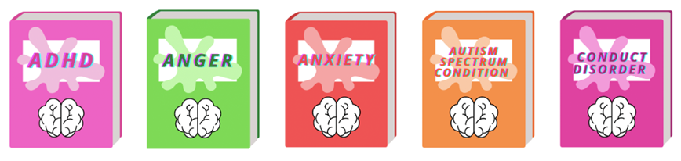
MindAid Youth: 2 Trials in primary & secondary
2 Trials
Trial 1
3 aspects of MHL measured
Trial 2
Primary & Secondary Schools 2020-22
10 schools,
N=1273 starters N=Completers=686
Longitudinal cluster-controlled design
10-13years,
mean 10.65
11-17 years,
mean 13.83
N=331, Int 204
PSHE lesson
Retention 76.6%
N=435, Int 299
Pastoral time
Retention 51.7%
54% female
56% female
Pote, Bemrose & Good (2022)

Slide 25
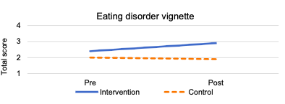
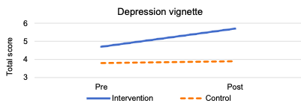
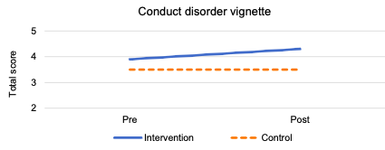
Trial 1
Trial 2
Notes:
Only improvements we saw were focused on MH knowledge for younger children 10-13years
Little impact on MH stigma
High initial engagement but Retention problems in both trials
Trial 1:
ANCOVA analyses:
Significant difference between groups on post intervention MHL knowledge scores (F(2,328)=7.827, p=.005) with the intervention group (mean=4.3) scoring significantly higher compared to the control group (mean=3.5).
Social anxiety knowledge not significant
Trial 2:
ANCOVA analysis:
With the trial with older young people, teenager, Non-significant results but some show improvements in ED and CD, not depression or SA
As found in previous trials No significant differences between groups on post-intervention help-seeking awareness or stigmatising attitudes scores
This remained non signif at one month follow up

Slide 26
Conclude
MindAid Youth improved younger children’s mental health KNOWLEDGE
Youth engagement was high in the short term
We need further studies: randomized with improved measures and better retention
Reflect
Young people’s experiences of using the product was positive
Consider if there are critical ages for digital intervention for MHL
Future
Need for more interactivity to achieve improvements beyond knowledge-based improvements
A blended approach to MHL interventions may be necessary
Notes:
Are MHL digital interventions helpful for youth?
Helping young people to better understand the signs and symptoms of specific mental health difficulties and how they are treated could facilitate improved outcomes for those who are struggling with their mental health through early intervention
Digital interventions have been particularly harnessed and relied upon during the COVID-19 pandemic, and it has been argued that the future of public health is likely to become increasingly more digital (Budd et al., 2020). Therefore, understanding the effectiveness of alternative intervention modalities is becoming progressively important. However, there is still a long way to go before firm conclusions can be established about the effectiveness of digital MHL interventions across MHL outcomes but also engagement in the intervention itself.
Seemed engaged
Not got great measures which can pick up on changes in MHL – improve these, high attrition, intervention fidelity - need further research which overcomes some of these limitations
Younger ???
Younger which delivered in class, unintentionally more blended = benefit more?
It is possible that digital content, no matter how interactive, may not be enough as a stand-alone intervention to shift other MHL components.
Perhaps interventions which are conducted in person, for example, with a person with lived experience of mental health difficulties or with a teacher or mental health professional who can hold reflective conversations with the young person and challenge assumptions.

Slide 27
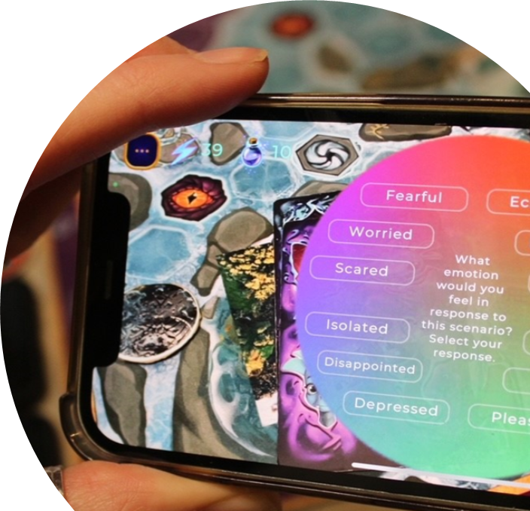

Example 2: Wellbeing Augmented Reality Board Game

Slide 28
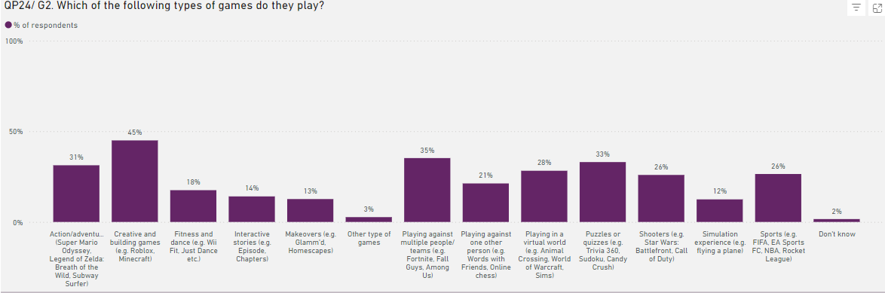
Young people are engaged in gaming
Ofcom 2024,
Notes:
Ofcom 2024,
3124 parents of 3-17year olds
Video gaming continues to be a key activity for children, rising from 57% in 2022 to
60% of all children aged 3-17. This increase is driven by children at both ends of the age
bands in our study. Children often use online gaming as a tool to communicate with their
peers, with 64% of 8-17s who game online chatting through the game with friends and/or
people they know in real life. However, 31% of children who game online, communicate
with strangers as well.

Slide 29
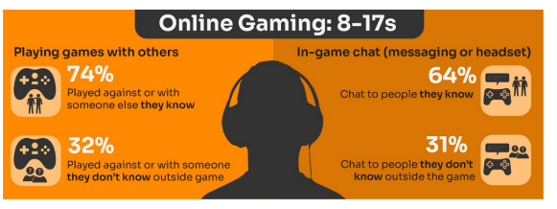
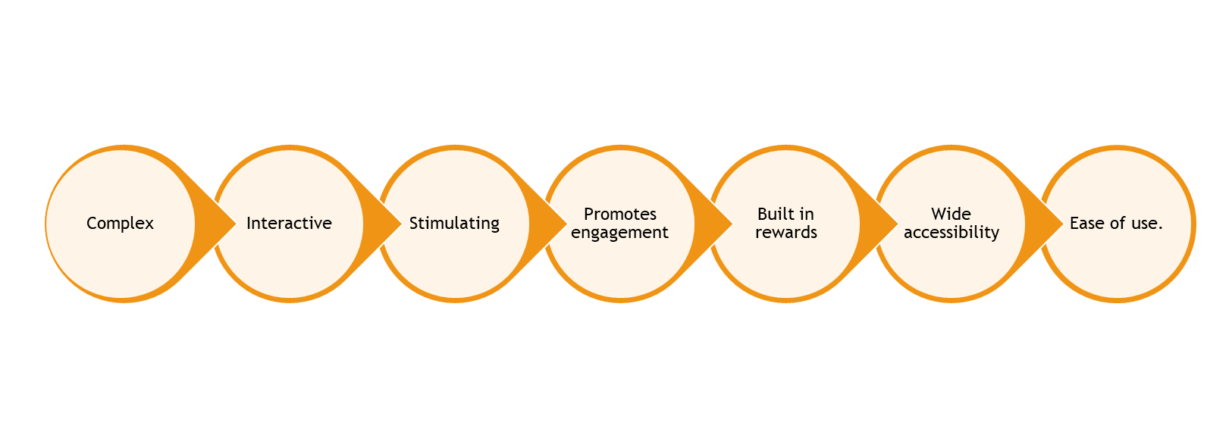
Gaming is surprisingly social…
Notes:
Ofcom 2024. N=2080
Online gaming is surprisingly social…Three-quarters (76%) of children aged 8-17 who game online chat through the game when playing,
and this increases with age, with 70% of 8-11s saying this compared to 79% of 12-15s and 16-17s. Boys in this group are more likely than girls to communicate with others while gaming (82% vs. 67%). With most chatting to people they know.
Serious games could be a great way of engaging reluctant teenage boys to talk about their wellbeing and mental health. Encouraging shoulder to shoulder communication rather than face to face direct conversations. Games have a number of characteristics which lend themselves to be good digital mental health tools

Slide 30
Serious games might improve adolescent health?
21 studies on games for ‘healthy lifestyle’ ‘sexual health’ and ‘substance use
Several studies demonstrate serious games can be engaging and pedagogically effective as a learning device and short term behaviour change
Health outcomes were harder to determine and not well measured and limited follow-ups
High-quality evidence is essential to the ongoing acceptance and use of these serious games as part of the school curriculum
Andrew et al. (2022)
Notes:
Serious games have demonstrated effectiveness for learning and behaviour change.
Advantages complex, interactive, stimulating, promotes engagement, built in rewards systems, wide accessibility, ease of use.
The applications of serious games have been prominent in the field of mental health Rodriguez et al, 2015; D’amico et al, 2018). Serious games have also been applied to increasing knowledge and improving behavioural outcomes in young people with cancer (Kato et al., 2008), improving type 1 diabetes self-management care in children and adolescents (DeShazo et al., 2010), improving functional outcomes in daily life for young people with attention deficit and hyperactivity disorder (ADHD) (Bul et al., 2016) and positive effects of providing sexual health promotion (DeSmet et al., 2014). Specific skill development has also been noted in the wider literature including improving memory, attention span, problem solving, emotional management and socialization (Granic et al., 2014).
D'Amico?
Example
Andrew L, Barwood D, Boston J, Masek M, Bloomfield L, Devine A. Serious games for health promotion in adolescents - a systematic scoping review. Educ Inf Technol (Dordr). 2023;28(5):5519-5550. doi: 10.1007/s10639-022-11414-9. Epub 2022 Nov 4. PMID: 36373044; PMCID: PMC9638273.
Review from Australia 2022 – 21 studies
Digital gaming has broad appeal globally, with a reported 2.7 billion gamers worldwide. There is significant interest in using games to enhance learning, with ‘serious games’ being included in classrooms to engage adolescents’ learning across a range of domains. A systematic scoping review of serious games used for health promotion with adolescents was conducted to identify serious games, review the methods used to evaluate these games, and outline evidence available to support the efficacy of these games in improving knowledge, beliefs/attitudes and behaviours in the target groups. Player engagement/enjoyment was reported if assessed. A total of 21 studies were found to have met the inclusion criteria domains: ‘healthy lifestyle’ ‘sexual health’ and ‘substance use’. A heterogenous approach across studies to game design and development, duration of game play, use of a control group and measurement of outcome(s) was observed. Game efficacy was difficult to assess due to broad generalisations and lack of consistent evaluation methods. Several studies demonstrate serious games can be engaging and pedagogically effective as a learning device and behaviour-change agent. Several studies, however, had less rigorous evaluation and lacked longer-term follow up. The ability for developers to demonstrate positive short- and long-term impacts of serious games with high-quality evidence is essential to the ongoing acceptance and use of these serious games as part of the school curriculum.

Slide 31

Game evidence from large national Youth MH trials: SPARX
SPARX is a tried and tested method of e-therapy, providing effective help with feelings of moderate anxiety and depression
Developed by Sally Merry and team in New Zealand and rolled out nationally free to all CYP
CBT informed
Multiple positive outcome trials since 2012

Slide 32

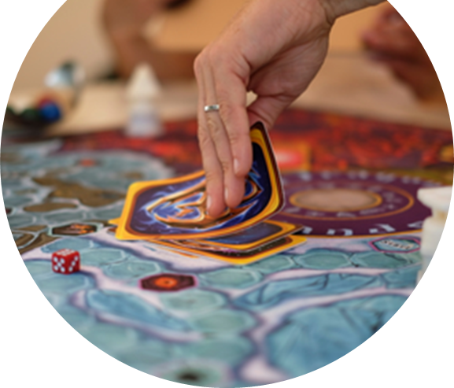
Dragons of Afterlands
An immersive, interactive, multi-player AR board game
It aims to improve wellbeing in young people, across physical, social, emotional and cognitive realms. 4 Dragon worlds with tasks.
It can be played in person, remotely or hybrid.
Co-developed with YP & a multidisciplinary team
Grounded in evidence-based psychological theory

Slide 33

Dragons of Afterlands Trial
Two-arm cluster trial over 5 weeks
2 schools
Game play vs PHSE lesson as usual
N= 71 adolescent girls 11-13yrs
Wellbeing outcomes compared pre /post /follow-up @1month
Wellbeing outcomes (WEMWBS and WHO-5)
Mechanisms of change; emotional awareness, emotional regulation, cognitive awareness, and social problem solving
Qualitative Grounded Theory analysis on game experience and change from young people
Clark, Rubio, Pote & Campbell (2024)

Slide 34
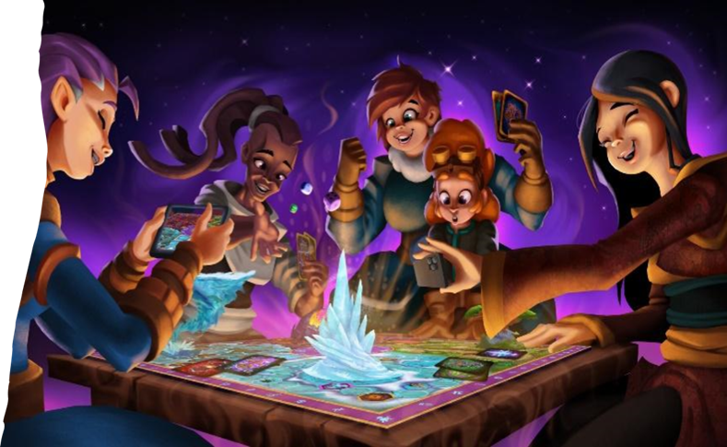
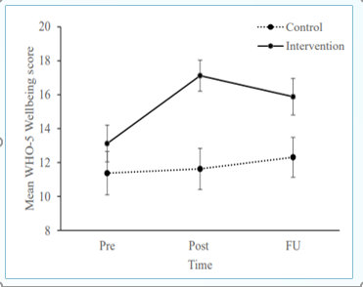
Results
Wellbeing Improvement: Adolescents playing the AR game reported significantly higher wellbeing scores post-intervention compared to the non-gaming control group on both WEMWBS and WHO-5.
The effects of the intervention waned over time – declining at follow up
Gameplay led to improved wellbeing through improvements in emotion awareness and emotion regulation skills
Notes:
Mixed ANOVAs Group (treatment vs control) x Time (pre, post, follow-up)
WEMWBS scores between baseline and post-intervention (p < .001), between baseline and follow-up (p =.029), and between post-intervention and follow-up (p = .001). Between-group comparisons showed that groups were only significantly different in WEMWBS scores post-intervention (p = .012).
The intervention group scored significantly higher at post-intervention (p < .001) and follow-up (p = .017) when compared to baseline.
and simple mediation analysis for emotional and cognitive processes from baseline to post intervention which may be mediating change

Slide 35
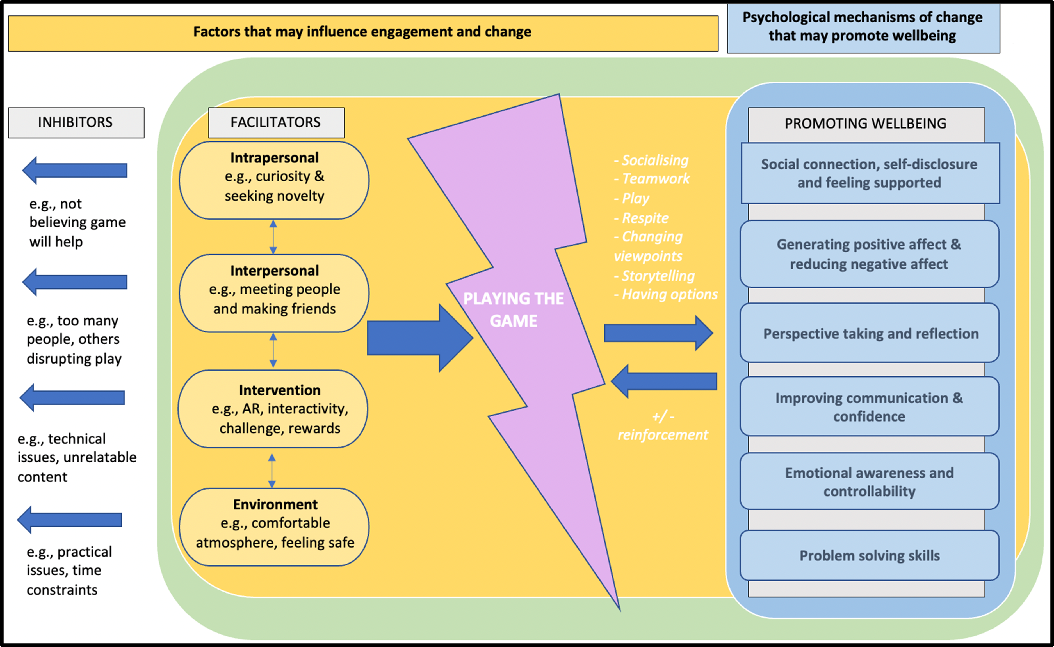
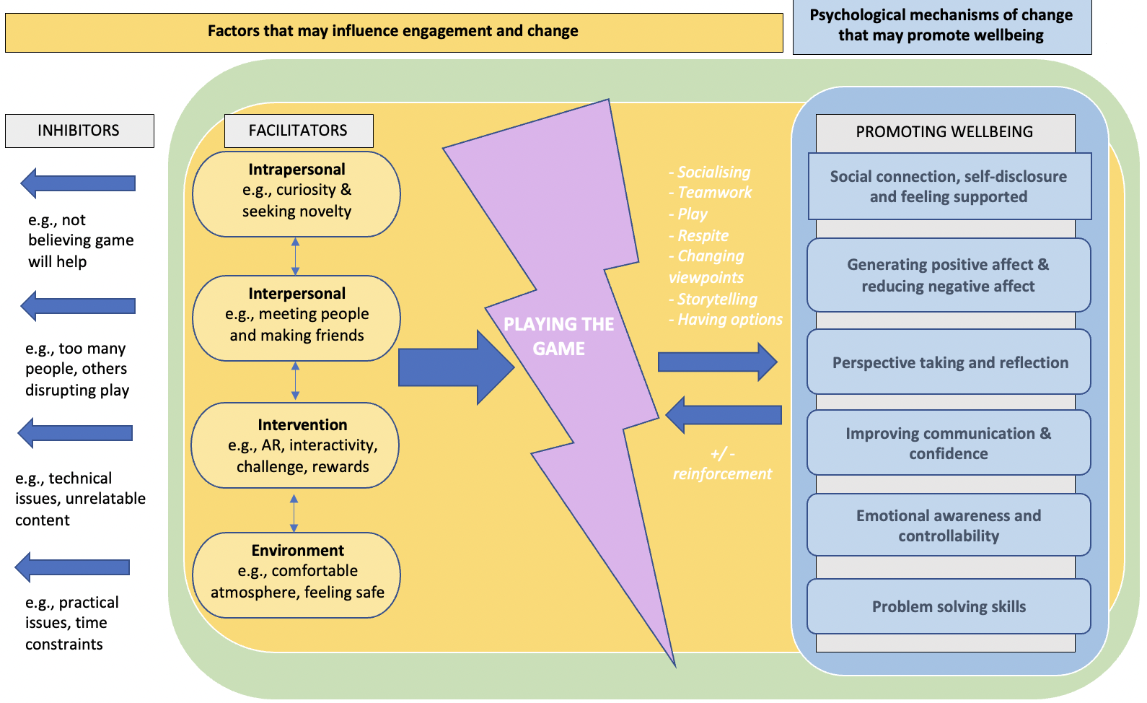
Notes:
Grounded Theory analysis of young people’s interviews found game engagement could be facilitated or inhibited by an interaction of intrapersonal, interpersonal, intervention and environmental factors.
The young people liked that the game offered a digital and human interactive experience, and many felt the game could support mental wellbeing.
Potential mechanisms of change were highlighted by the young people including that the game facilitated:
Social connection;
Positive emotional experiences, and reduced negative affect;
Perspective taking and Reflection;
Communication and Confidence;
Emotional Awareness and Controllability;
Problem-solving skills.
The opportunity to socially connect in real-life with peers during gameplay was considered a key benefit of the intervention, both for facilitating engagement and psychological change.

Slide 36

Reflection and join us:
What are your immediate reactions to games like DoA?
What would prevent you from using a DoA within your school / service?
Would you like to offer feedback to shape DofA V2?

Slide 37
Barriers to EdTech in Schools
Limited IT Infrastructure – poor internet connectivity
Staff digital Capability & Skills
Staff attitudes
Parental caution
Concerns about privacy, safety and data security
School educational priorities
Procurement Capabilities
Notes:
We learnt a lot in developing these 2 products in collaboration with schools - many of which we similar to health settings
Realising the potential of technology in education DfE (2019)
According to data from Ofcom, there are
at least 500 schools in areas in England
struggling with slow connections to the
building, with around 100 of these in
areas with average download speeds as
low as 1-2Mbps. This connection speed
prevents teachers from streaming video
content without buffering, from working
collaboratively with online tools, or from
moving storage solutions to the cloud (see
below). - Full fibre connectivity to address

Slide 38
Facilitators to Mental Health EdTech in Schools
Clear tech strategy in school
Integrating technology into the curriculum – what is taught, how it is taught
Shifting teacher – student roles
AR create immersive learning experiences
AI personalisation of student experience
Platforms connecting students and educators (across borders)
Notes:
To conclude
About to build AI into the game

Slide 39

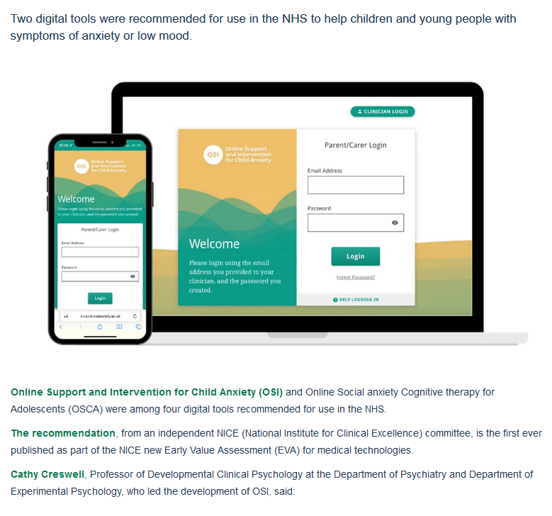
Importance of using quality digital products
NICE approved
NHS & Social Care evaluations of digital interventions - DTAC
https://transform.england.nhs.uk/key-tools-and-info/digital-technology-assessment-criteria-dtac/

Slide 40
Importance of training teachers
In health settings, educating and supporting staff to use and implement digital health interventions has been critical to success
The same is needed for teachers and education staff
Interesting approaches in Scotland – Teacher Digital Skills Toolkit - to help teachers evaluate their own digital literacy skills and identify strengths or next steps for developments
https://education.gov.scot/resources/teacher-digital-skills-toolkit/
www.digitalhealthskills.com
Notes:
https://www.twinkl.co.uk/news/dfe-launches-call-for-evidence-on-ai-in-schools

Slide 41

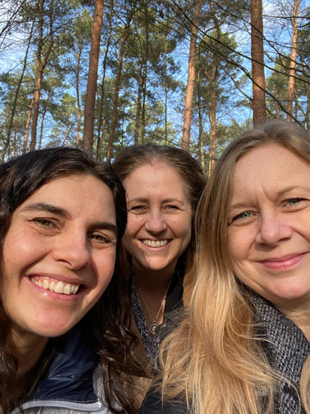
July 2024
Editors:
Prof Helen Pote,
Dr Anna Picciotto
Dr Clare Norris
Notes:
Co-Edited with Directors of Child NHS Psychology Services, across Herts and North London. The book focusses on child psychological practice and Wiley will be publishing this in a couple of months. I have written several chapters including one on working in schools and one on digital practice.

Slide 42
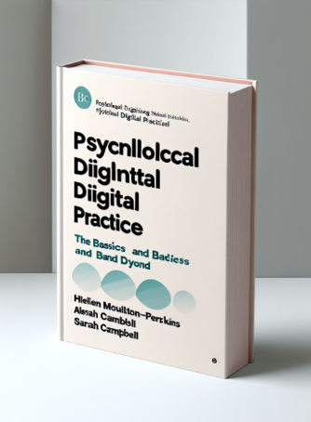
Autumn 2024
Digital Psychological Practice – The Basics & Beyond
Open University Press.
Editors:
Professor Helen Pote,
Dr Alesia Moulton-Perkins
Dr Sarah Campbell
Notes:
Appy pie buit me a book cover
The book is about the knowledge, skills and professional issues for digital practice by psychological clinical professionals. It is aimed as a core text for students and qualified psychological practitioners wanting to engage in ethical digital practice to support wellbeing at many levels of delivery, from online of therapy to immersive gaming interventions.

Slide 43


Thank you
h.pote@rhul.ac.uk
https://royalholloway.ac.uk/research-and-teaching/departments-and-schools/psychology/research/serns/
www.digitalhealthskills.com
Notes:
Thank you. Come and join me for a cake.

Slide 44
Resources & References
Mental Health of Children & Young People in England, NHS Digital 2023. https://digital.nhs.uk/data-and-information/publications/statistical/mental-health-of-children-and-young-people-in-england/2023-wave-4-follow-up
DfE Realising the potential of technology in education: A strategy for education providers and the technology industry (2019) https://assets.publishing.service.gov.uk/media/5ca360bee5274a77d479facc/DfE-Education_Technology_Strategy.pdf

Slide 45
Andrew L, Barwood D, Boston J, Masek M, Bloomfield L, Devine A. Serious games for health promotion in adolescents - a systematic scoping review. Educ Inf Technol (Dordr). 2023;28(5):5519-5550. doi: 10.1007/s10639-022-11414-9. Epub 2022 Nov 4. PMID: 36373044; PMCID: PMC9638273.
https://www.samaritans.org/about-samaritans/media-guidelines/guidance-for-reporting-on-self-harm-and-suicide-content-online/
https://beat.contentfiles.net/media/documents/Beat_Media_Guidelines.pdf

